Slide 1

On the Cutting Edge of GIST:
Novel Surgical Approaches
Jason Sicklick, MD
Associate Professor of Surgery

Slide 2
Disclosures
Investigator-initiated Trial Sponsored by Novartis Pharmaceuticals (2013 – present)
Investigator-initiated Trial Sponsored by Foundation Medicine (2015 – present)
Consultant, Sirtex (2015)
Consultant, Grand Rounds (2015 - present)
Research funding, Blueprint Medicines (2015)
Consultant, CARsgen Therapeutics (2017)

Slide 3
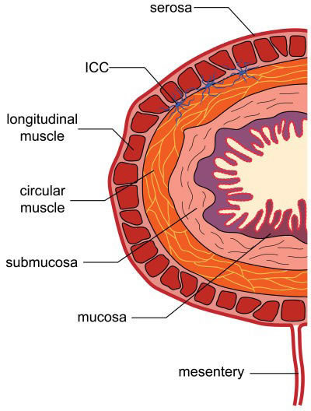
ICCs are Submucosal Cells
ICC

Slide 4
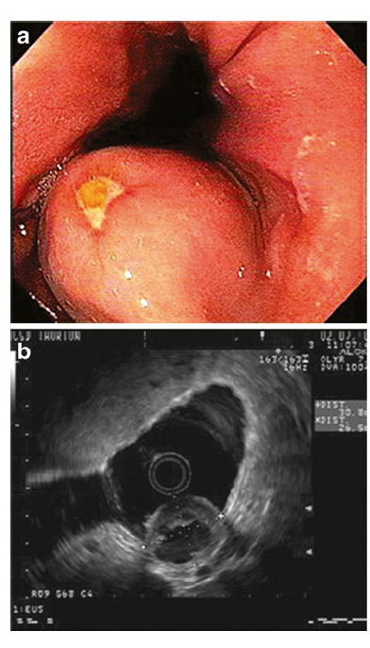
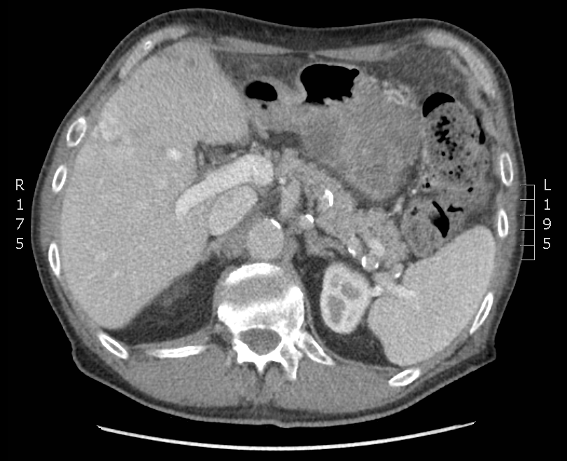
Submucosal Tumor (SMT) Growth Pattern
Endophytic
Exophytic
SMT DDx: leiomyoma, leiomyosarcoma, schwannoma, pancreatic heterotopia, gastric cavernous hemangioma

Slide 5
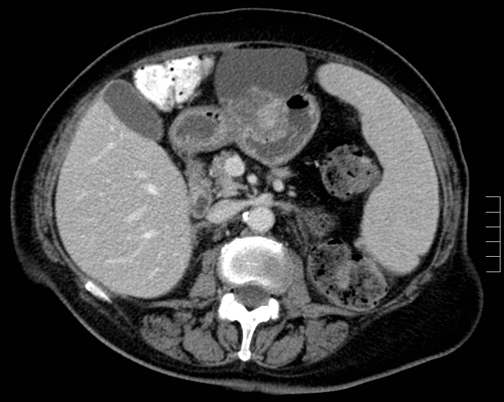
Spectrum of Clinical Presentation
Asymptomatic
Incidentally discovered (median size 3 cm)

Slide 6
Spectrum of Clinical Presentation
Non-specific Symptoms
    Nausea/vomiting
    Abdominal pain
    Abdominal distension
    Early satiety

Slide 7
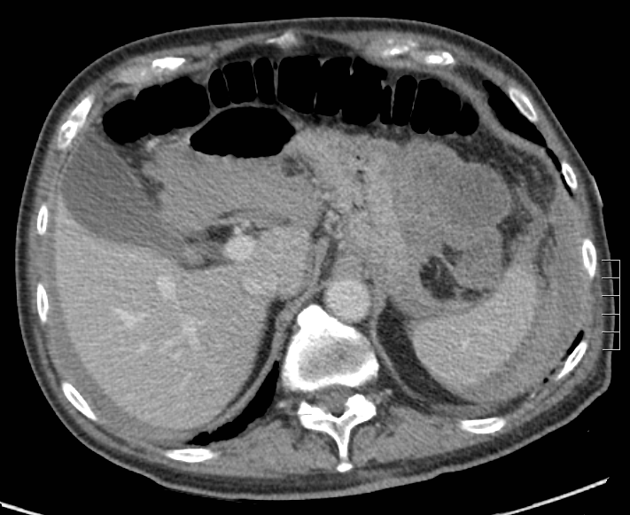
Spectrum of Clinical Presentation
Bleed
Slow bleeding
  Anemia
  Melena
Acute bleeding
  Intraluminal erosion
  Intra-peritoneal rupture

Slide 8
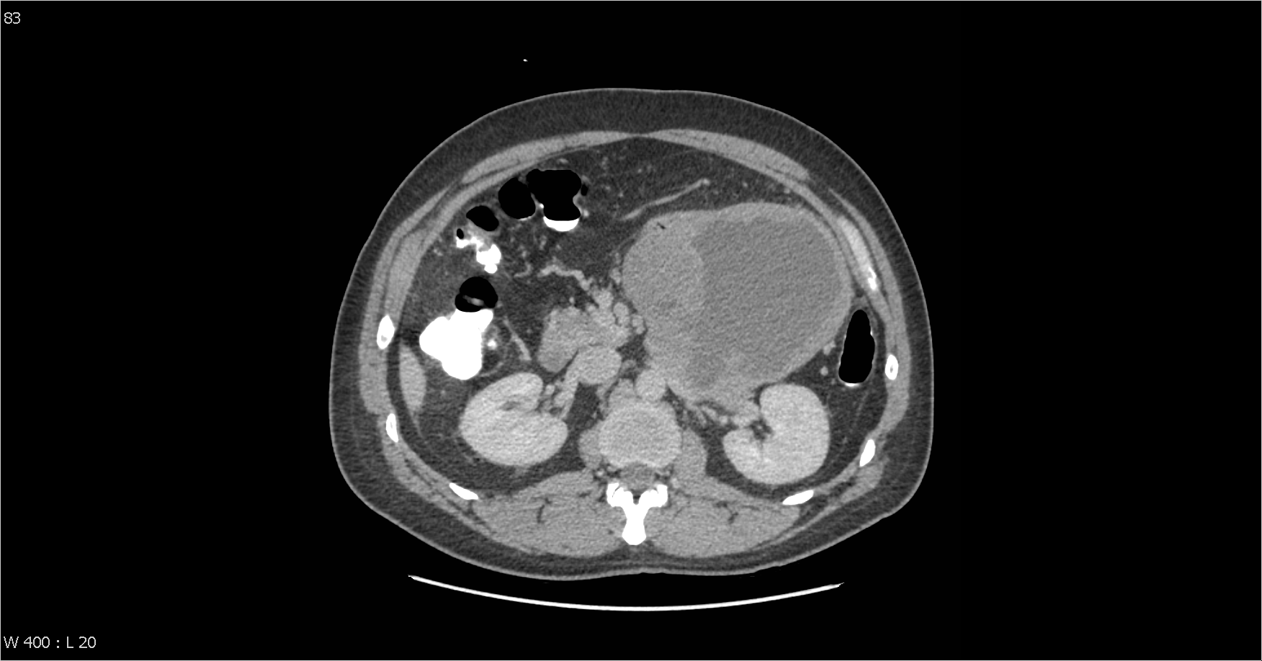
Spectrum of Clinical Presentation
Perforate
Acute onset pain
Fever
Leukocytosis

Slide 9
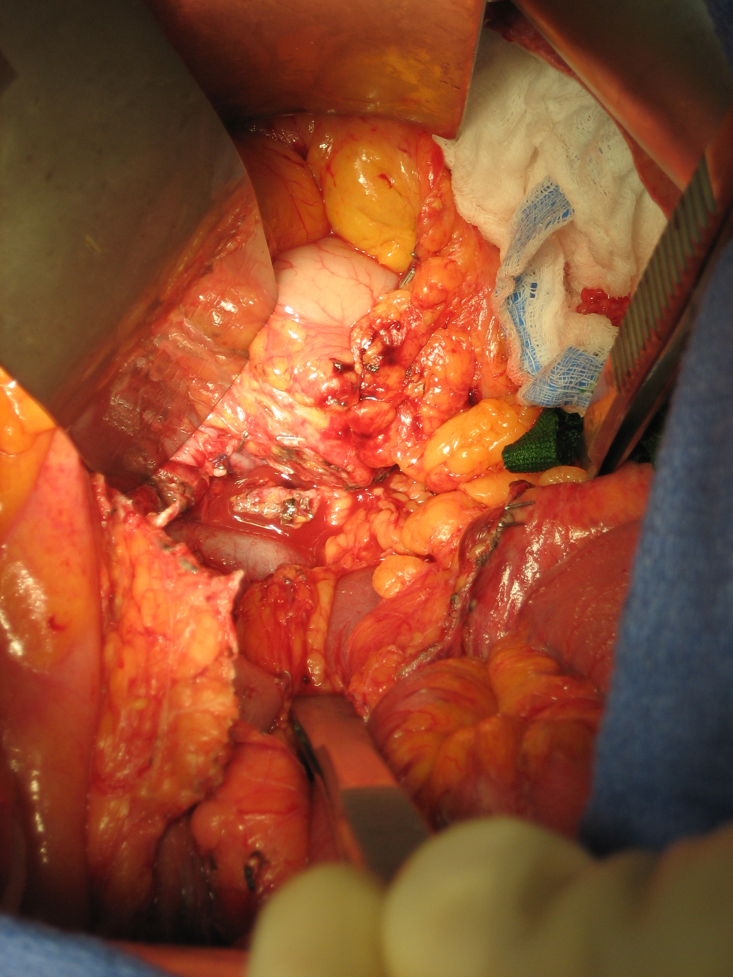
Tumor Biology
Push
Rarely Invade
Left Renal Vein

Slide 10
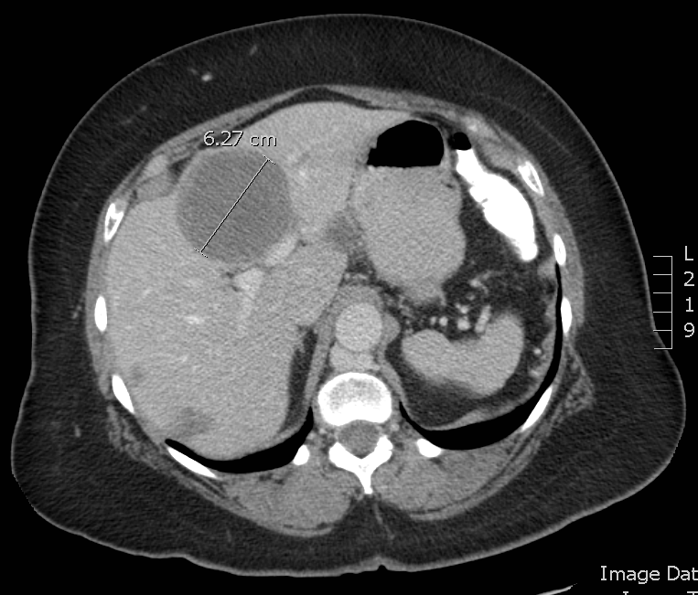
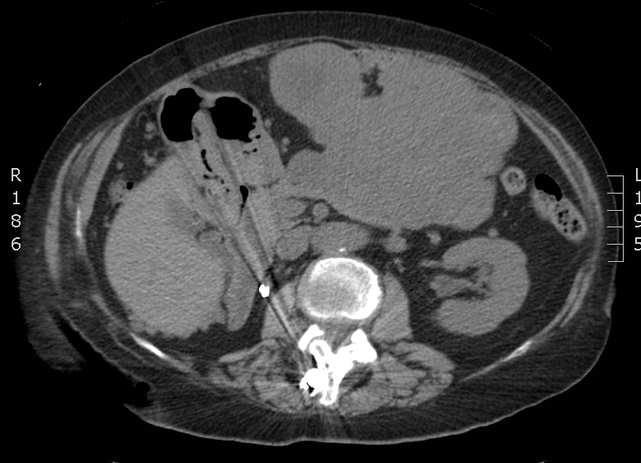
Hematogenous (Not Lymphatic) Spread
Liver Metastases
Peritoneal Metastases
< 1/3 patients have both types of metastases
Nodal and other metastases are rare

Slide 11
Survival in the Era of TKIs
38 x 25 x 12 cm
Entire GIST cohort
  5-year DSS: 79%
  5-year OS: 65%
5-year OS by Stage
  Localized disease: 77%
  Regional disease: 64%
  Distant metastases: 41%
Ma…Sicklick, Cancer Epidemiology, Biomarkers & Prevention. 2015

Slide 12
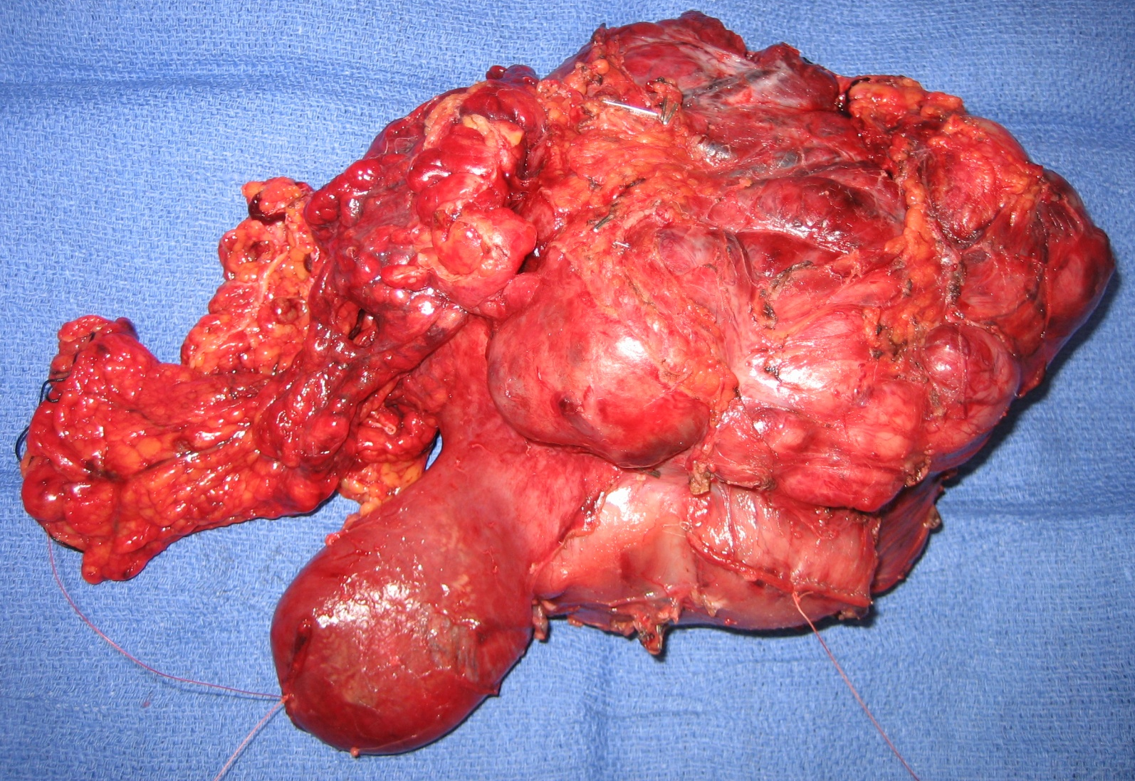
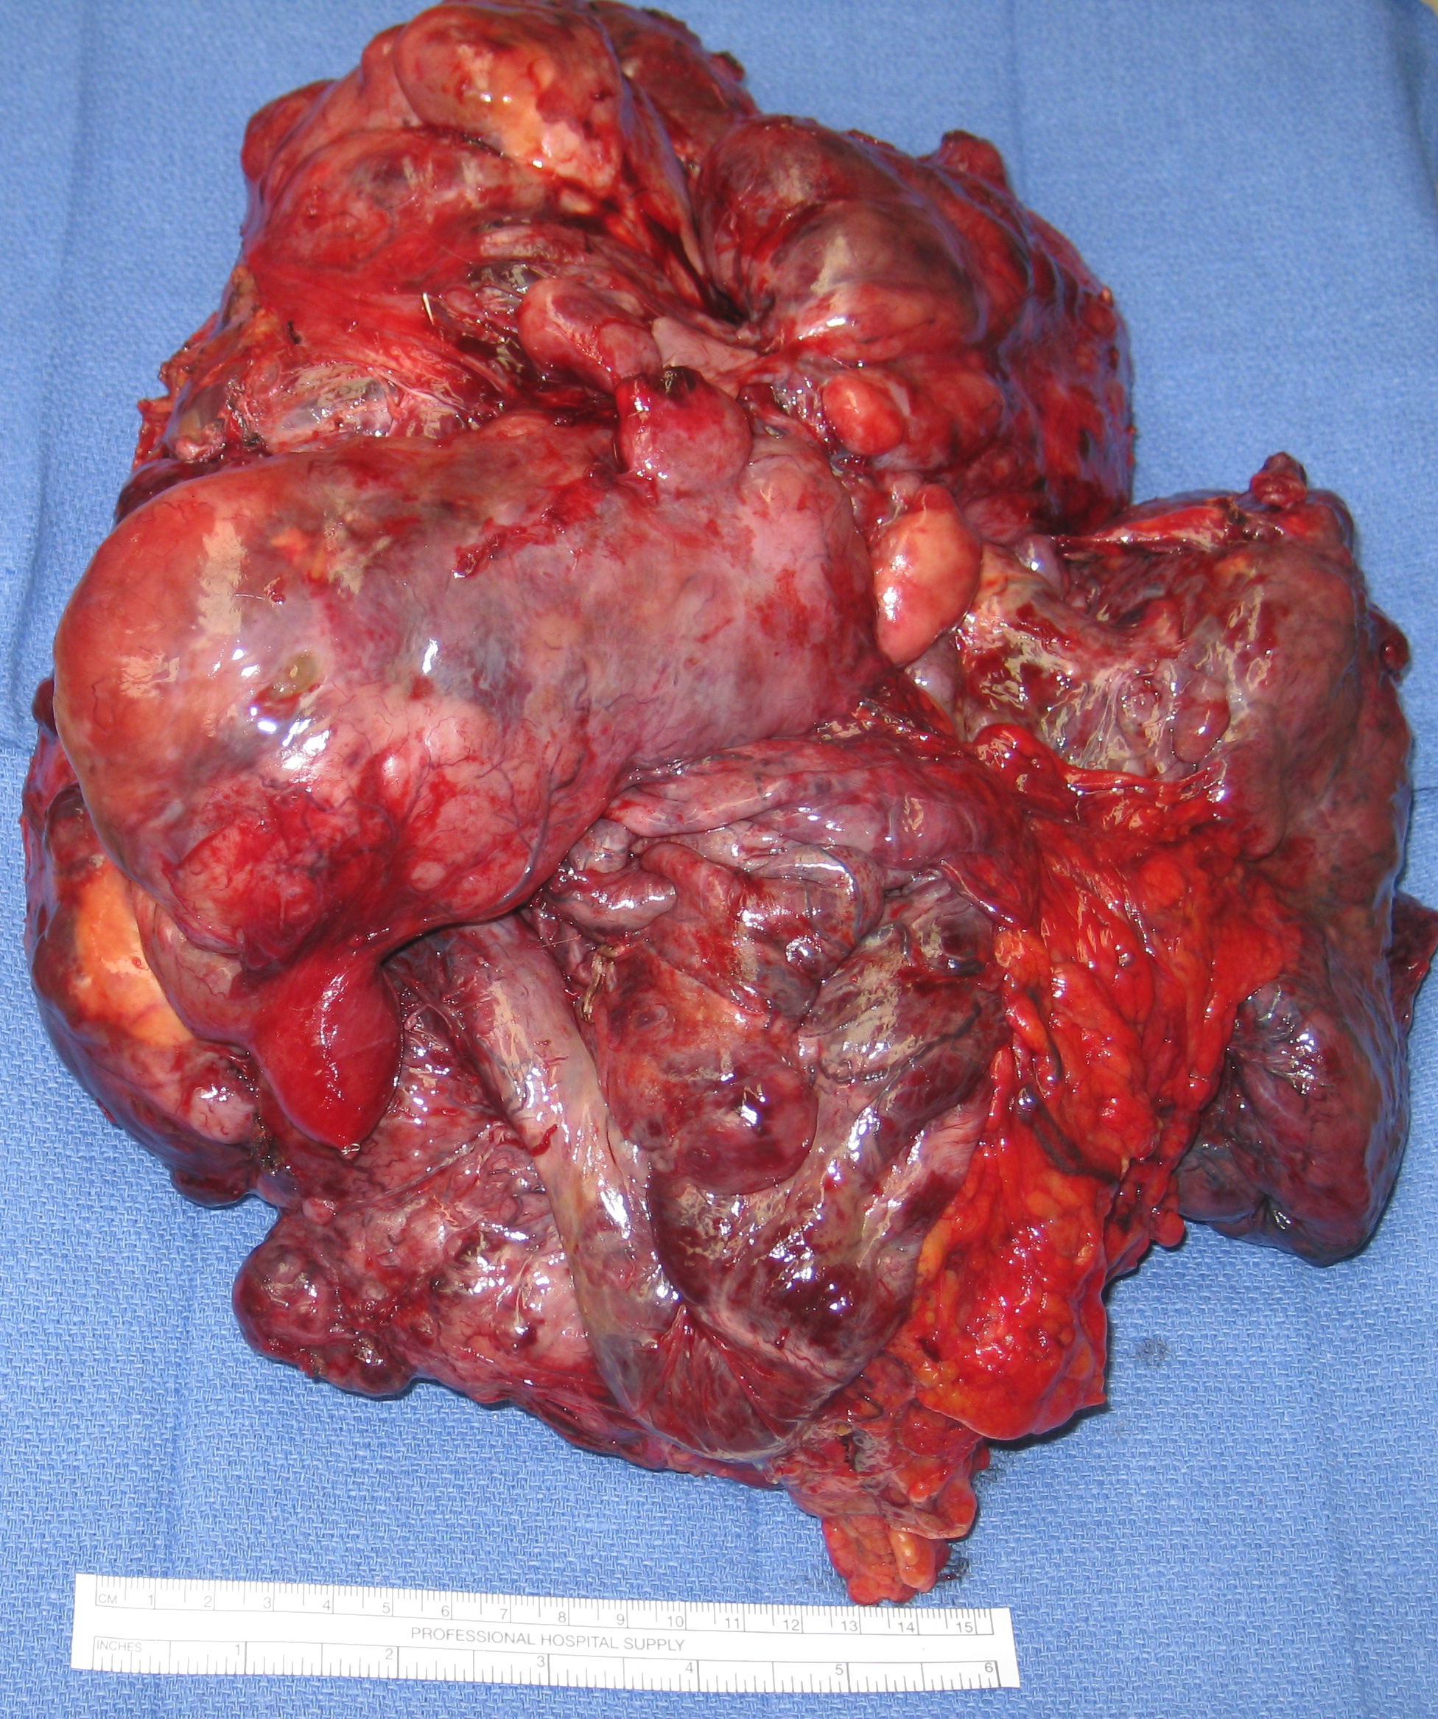
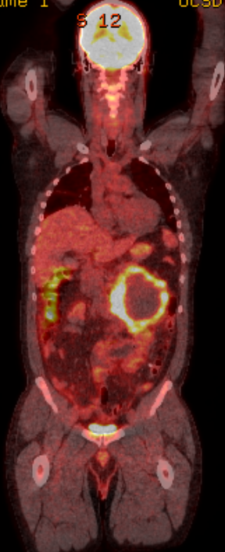
Surgery is the Primary Treatment
Potentially Curative

Slide 13
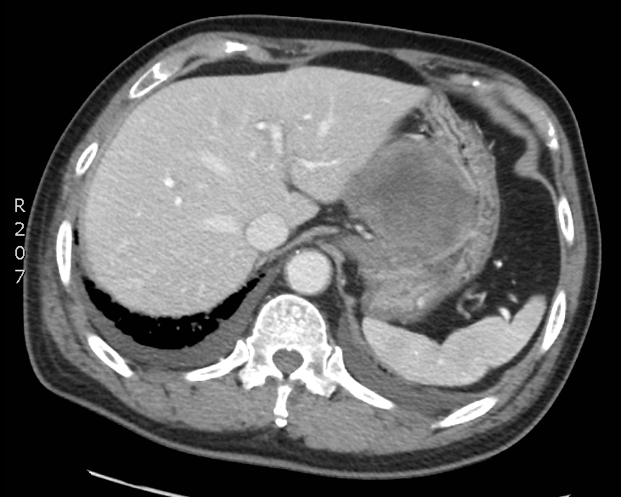
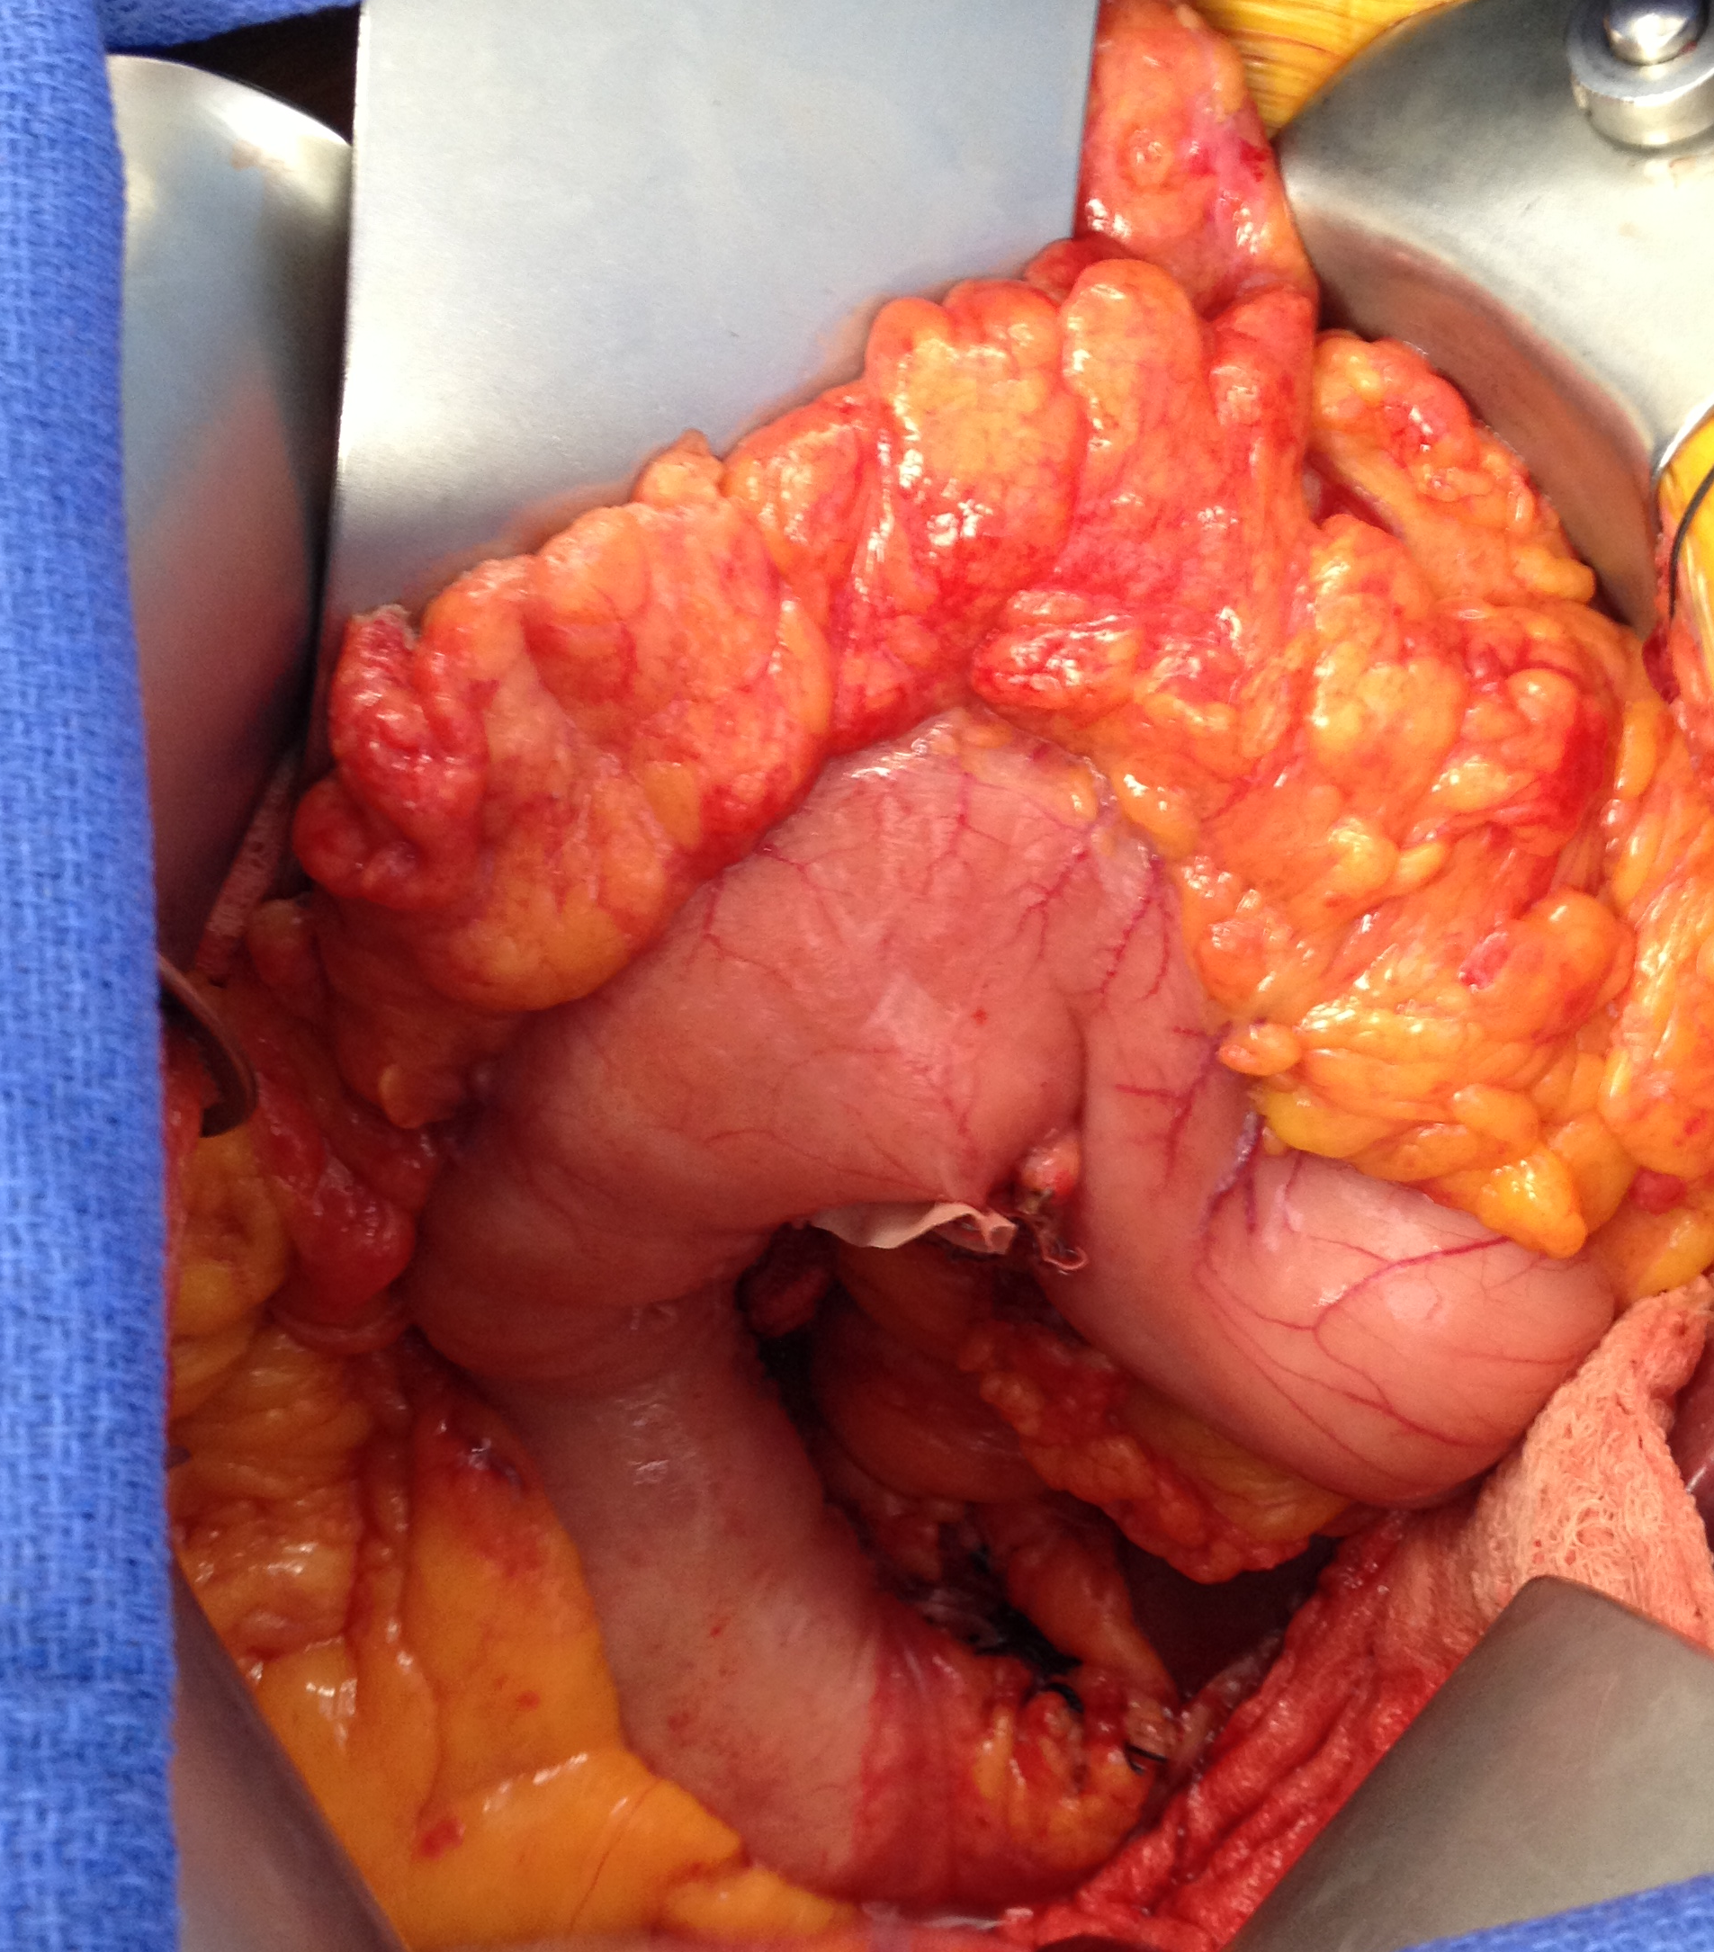
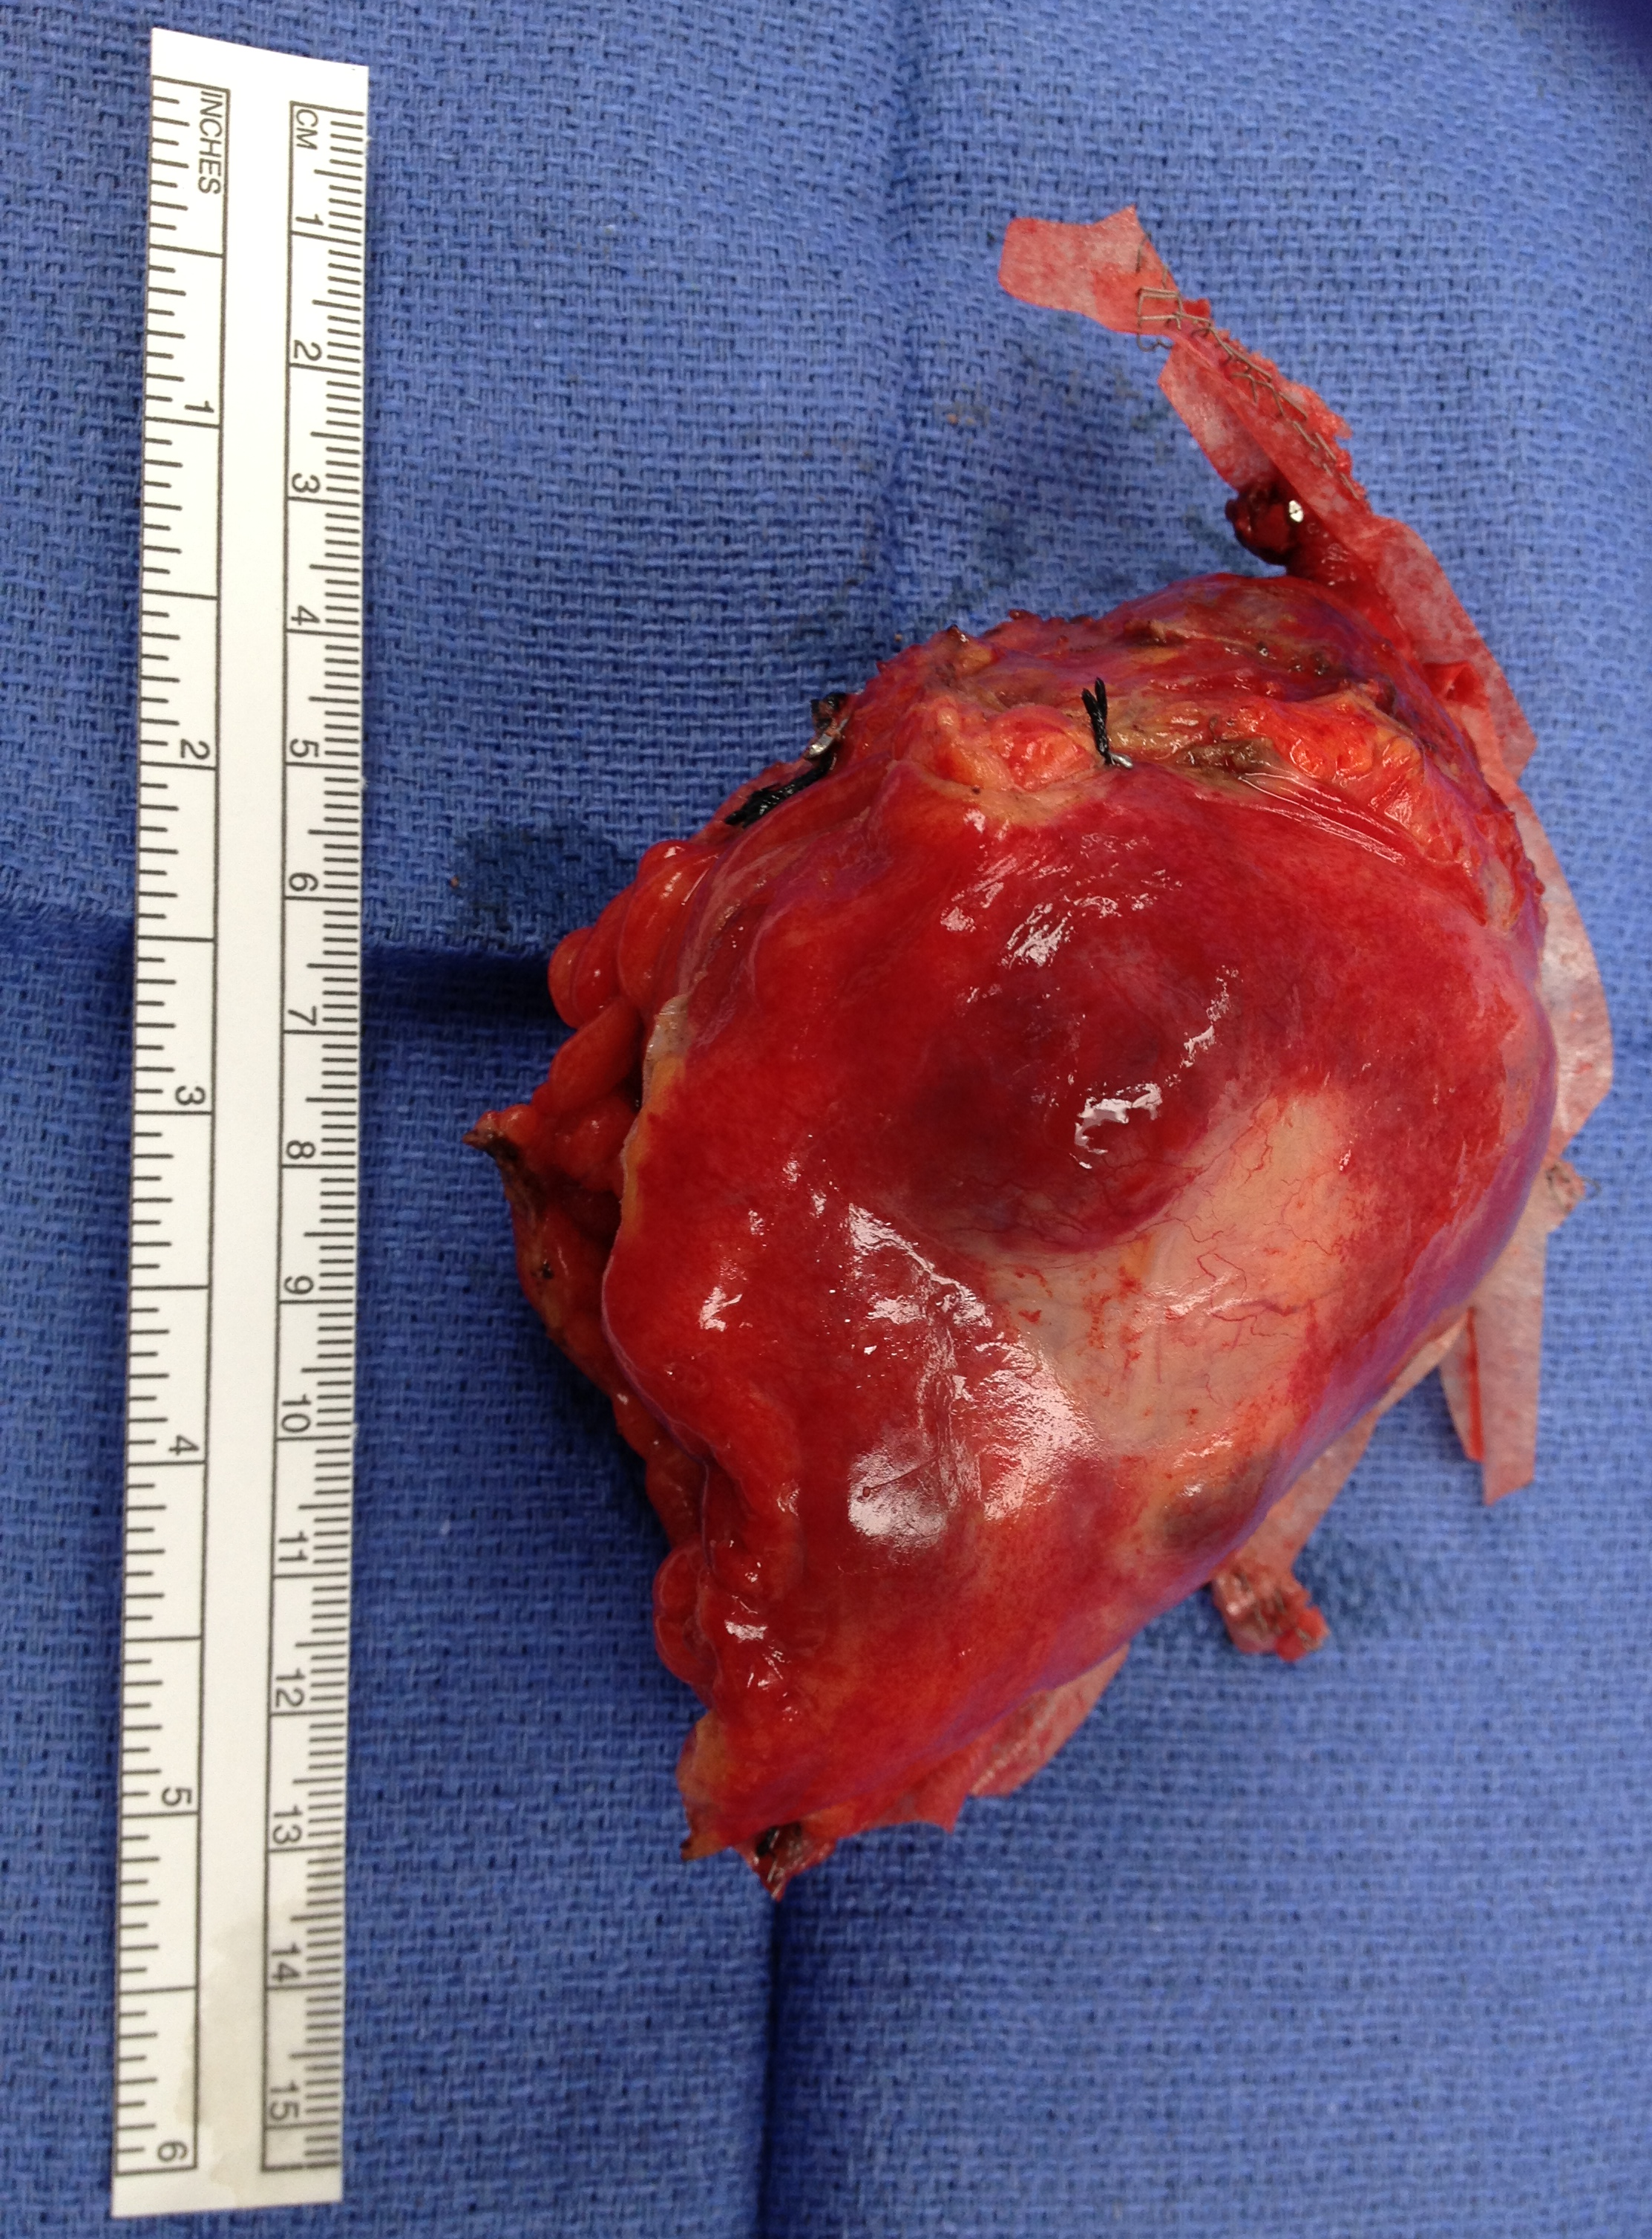
Goals of Surgical Treatment
Total gross resection
Negative microscopic margins
Intact pseudocapsule without tumor rupture
Because LN metastases are uncommon, lymphadenectomy is not generally indicated

Slide 14
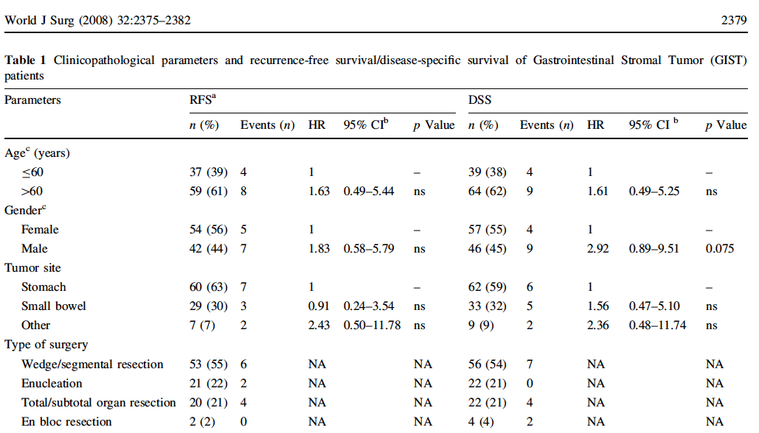
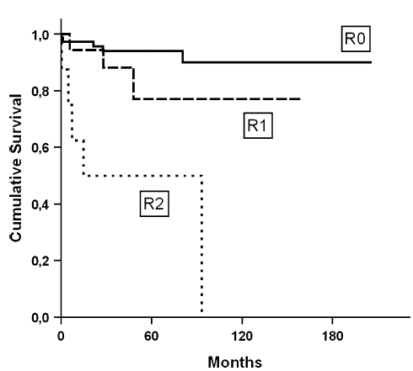
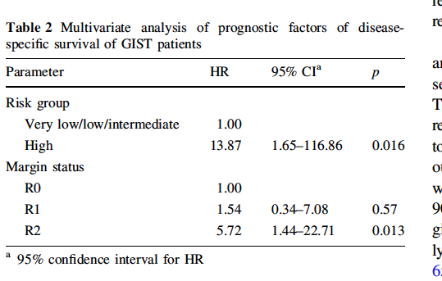
Surgical Margins, Not the Technique, Dictate Prognosis
RFS
DSS
Gouveia et al., World J Surg. 2008

Slide 15
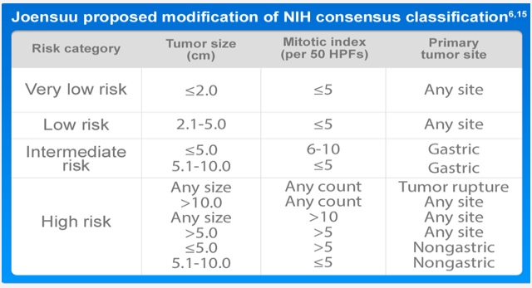
Tumor Rupture is a Poor Prognostic Factor
Risk of Recurrence: Modified NIH (Joensuu)
Joensuu H. Risk stratification of patients diagnosed with gastrointestinal stromal tumor. Hum Pathol. 39(10), 1411-1419 (2008).

Slide 16
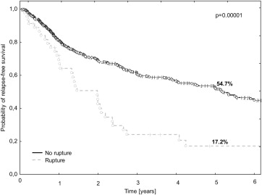
Tumor Rupture Influences Recurrence-free Survival
P=0.00001
No Tumor Rupture (N=594)
Tumor Rupture (N=46)
P. Rutkowski , et al., Validation of the Joensuu risk criteria for primary resectable gastrointestinal stromal tumour – The impact of tumour rupture on patient outcomes. European Journal of Surgical Oncology (EJSO), Volume 37, Issue 10, 2011, 890 - 896

Slide 17

Balancing Operative Approach
Cosmesis and Recovery
Oncologic Outcomes

Slide 18
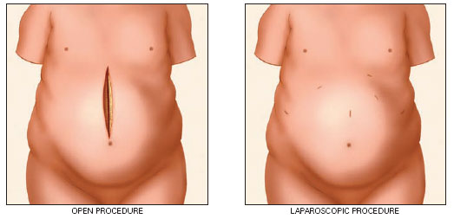
Operative Approach: Means to an End

Slide 19
Laparoscopic Approach
ADVANTAGES
Shorter incision length with lower hernia risk
Less pain
Shorter length of stay
Lower blood loss
Decreased ICU admissions
No oncologic disadvantages in experienced centers with experience surgeons (i.e., pancreas, liver, gastric, colon cancers)

Slide 20
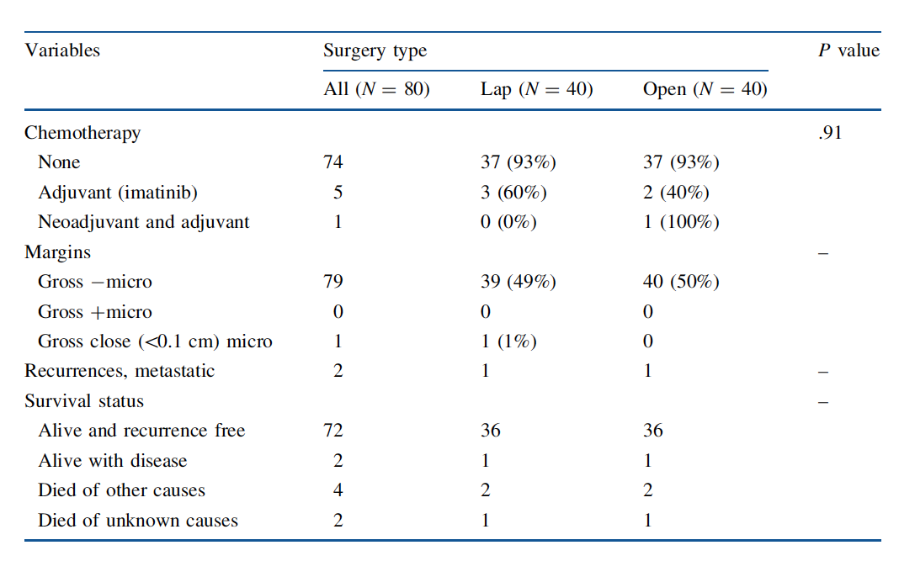
Lap vs. Open Gastric Resections for GIST
No Difference in Oncologic Outcomes
Karakousis et al., Ann Surg Onc. 2011

Slide 21
Operative Approach: Questions to Ask
Tumor Factors
Can total gross resection be achieved safely (for either local, regional or metastatic disease)?
Is the tumor small enough to be manipulated laparoscopically?
Is the tumor invading adjacent structures?
Even if a laparoscopic resection is feasible, how large will the incision be to remove the tumor?

Slide 22
Operative Approach: Questions to Ask
Tumor Factors
Is tumor rupture a significant concern?
Is this a primary tumor or a recurrence…will the surgical bed be “stuck”?
Is there concern for multi-focal disease?
With preoperative (neoadjuvant) therapy, could tumor shrinkage change the resection, make it safer, or make it easier?

Slide 23
Operative Approach: Questions to Ask
Patient Factors
Is the patient an appropriate operative candidate…other medical problems?
Has the patient had prior abdominal operations-laparoscopic or open?

Slide 24
Operative Approach: Questions to Ask
Surgeon Factors
Is the surgeon skilled at a laparoscopic approach?
Best approach is what the surgeon is most comfortable with.

Slide 25
Operative Approaches in GIST
Surgical Technique | Advantages | Limitations (Evidence) | Tumor location | Disadvantages
Laparoscopy | Full-thickness resection of stomach wall; negative margins; minimal risk of dissemination; shorter hospital stay | Small studies (N=4–61) | Stomach; small bowel | Can be technically challenges with larger tumors > 10 cm
Laparotomy | Better visualization and mobilization of larger tumors or those in technically challenging locations | Small case series; retrospective studies | Any | Longer hospital stay; More blood loss; Longer operation time Reflect a selection bias because large tumors may not be resectable by laparoscopic approach
Sicklick and Lopez, Journal of GI Surgery. 2013.

Slide 26
What Approach is Appropriate?

Slide 27
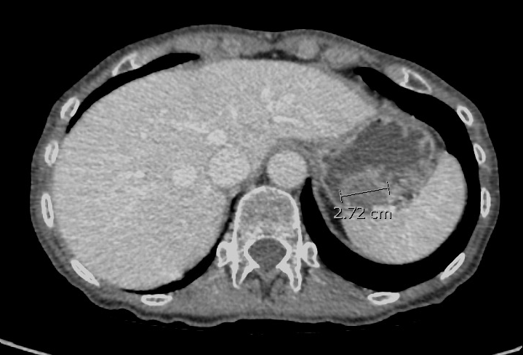
How should one approach resecting a GIST close to the GEJ…Open vs. Laparoscopic?
GEJ

Slide 28
Operative Approaches in GIST
Surgical Technique | Advantages | Limitations (Evidence) | Tumor location | Disadvantages
Endoscopy | Minimally invasive; potentially shorter operation time | Small series; retrospective study Limited data on long-term outcomes | Esophagus; stomach; rectum for small lesions (1-3 cm) | Often leaves positive margins with capsular invasion and/or tumor rupture Complications: perforation, pneumothorax (9.4%), and GI bleeding (5%)
Sicklick and Lopez, Journal of GI Surgery. 2013.

Slide 29
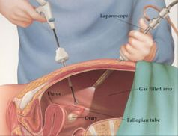
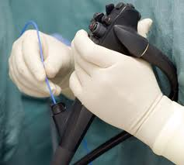
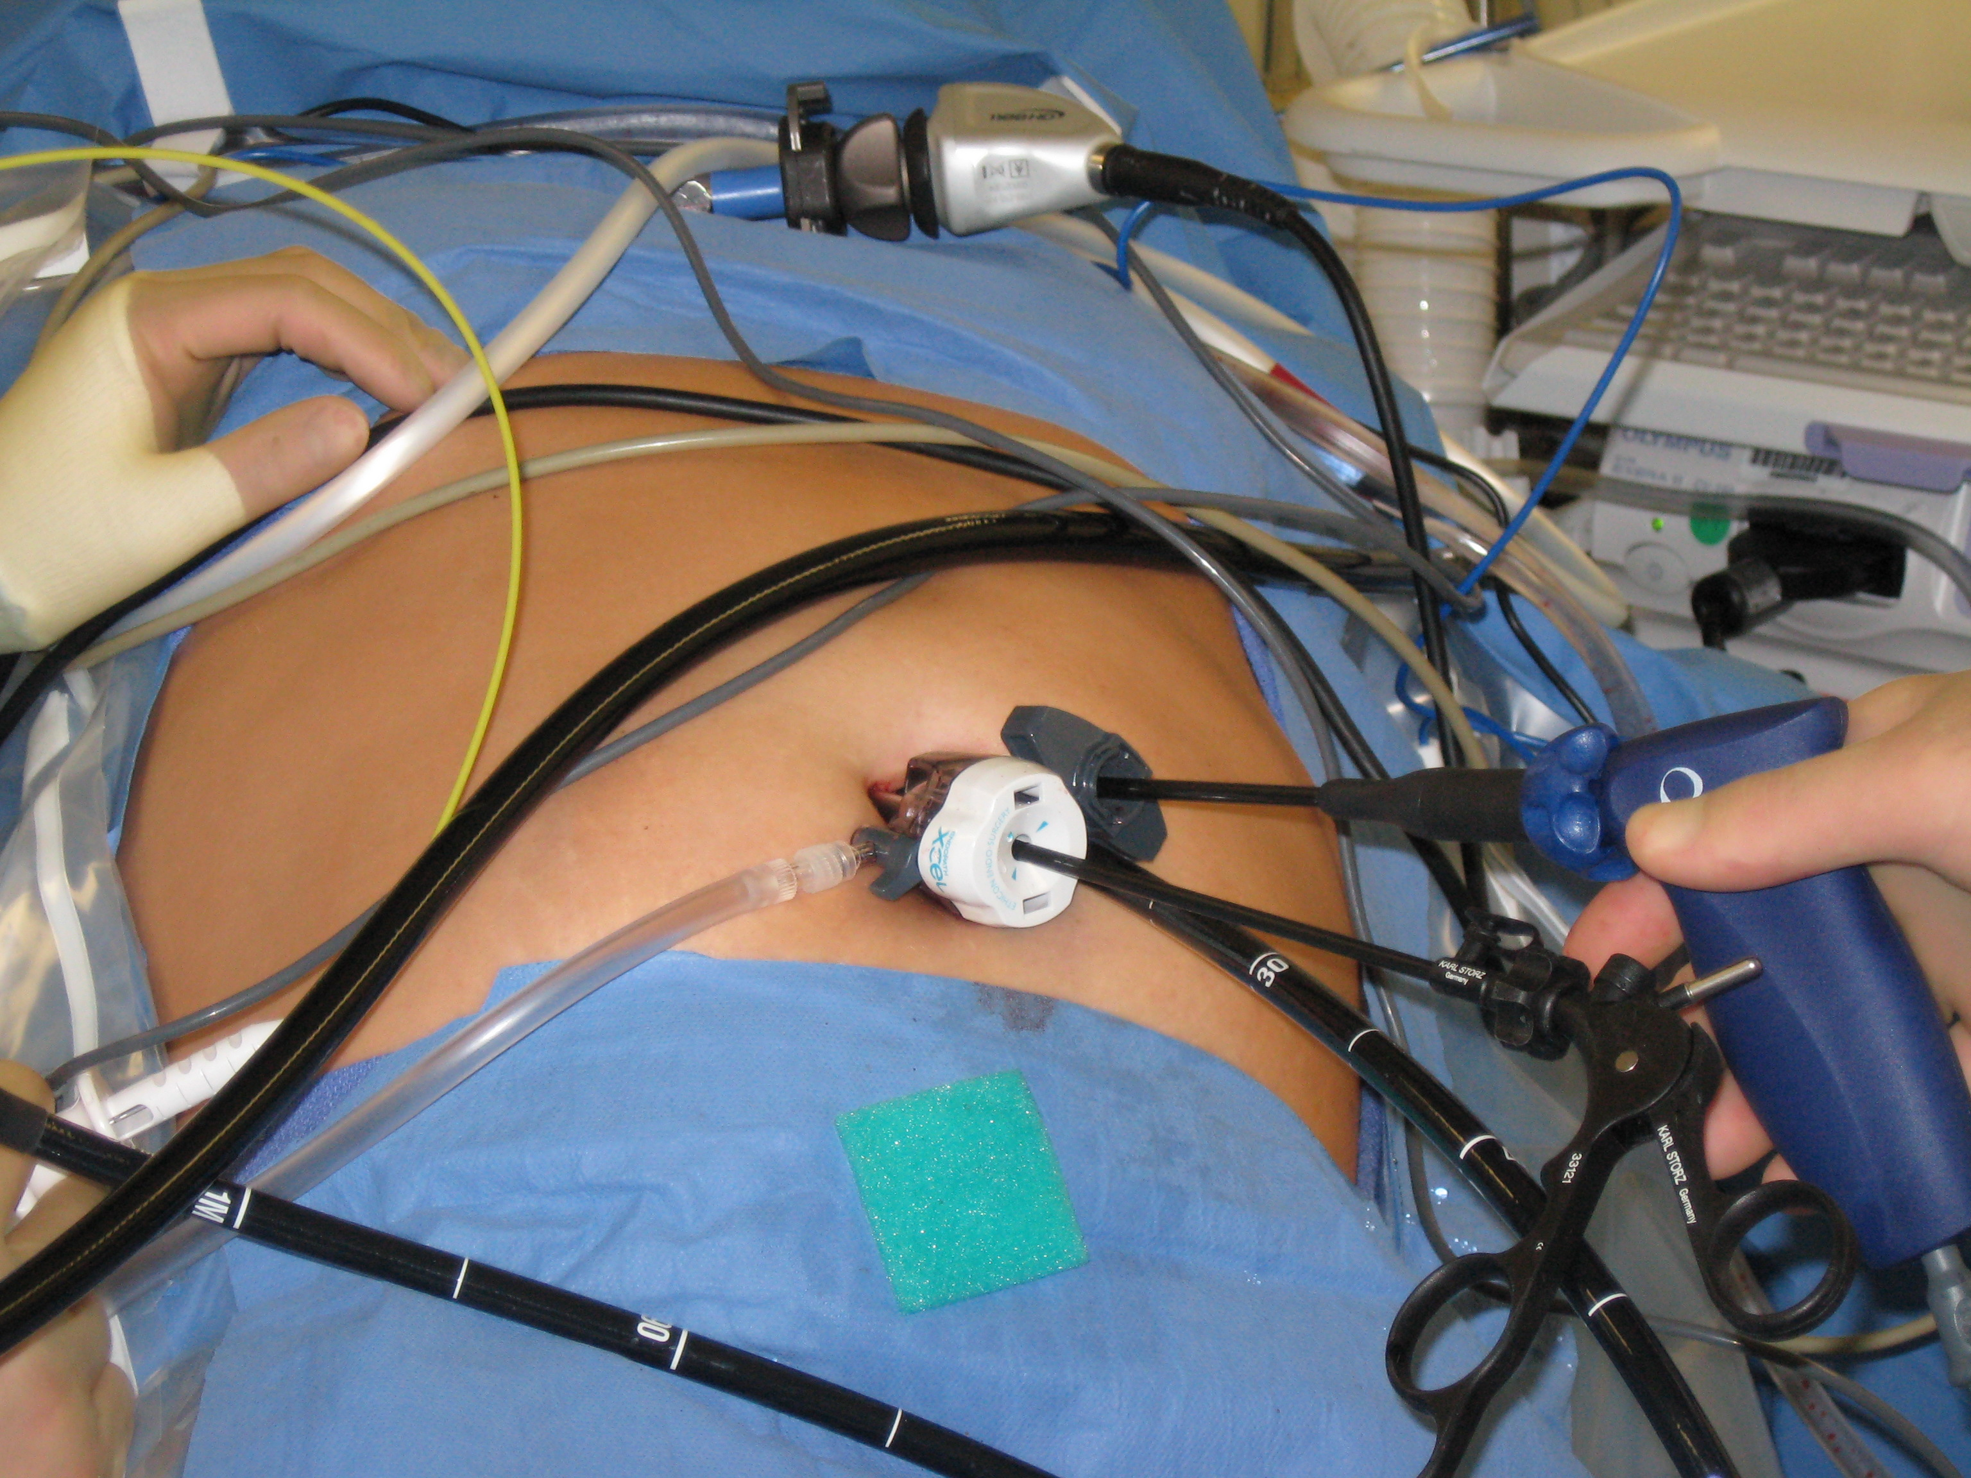
Emerging Surgical Approach
Laparoscopy
Endoscopy
+
Laparo-Endoscopy

Slide 30
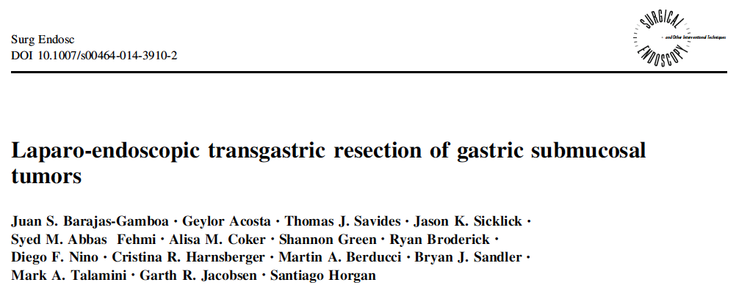
Operative Approaches in GIST
Surgical Technique | Advantages | Limitations (Evidence) | Tumor location | Disadvantages
Laparo-endoscopy | Monitor endoscopic resection; repair injury/perforation | Case reports and series | Stomach; duodenum | Technically demanding
Sicklick and Lopez, Journal of GI Surgery. 2013.

Slide 31
Laparo-Endoscopic Surgical (LES) Approach
ADVANTAGES
Extra working port via the endoscope in order to minimize instrument changes while decreasing the clutter/clashing of additional trocars/instruments
Improved ability to visualize remote locations in the abdomen given the endoscope’s flexibility
Superior ergonomics when compared to single access laparoscopic surgery

Slide 32
Lessons Learned
Takes a team approach with coordination between surgeons and gastroenterologists
Approach reduces the number of trocars
Avoids large gastric resections for proximal gastric tumors
Oral extraction is generally safe and feasible for tumors < 3-4 cm in size

Slide 34

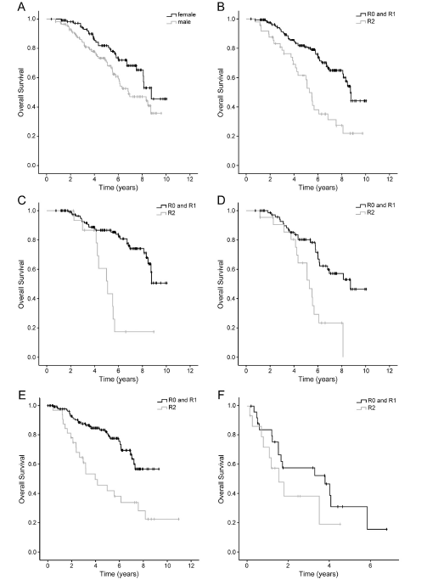
Limited Metastatic Disease
OS from first imatinib
Long-term survival in patients in whom surgical complete remission can be achieved.
Incomplete resection, including debulking surgery does not seem to prolong survival.
Gender, P=0.025
R status, P=0.0001
Non-PD, P=0.0001
Exon 11, P = 0.001
OS from metastectomy
Non-PD, P<0.00001
PD, P=0.2
Bauer et. Al., Eur J Surg Oncol. 2014 Apr;40(4):412-9

Slide 36
Summary
Although surgery remains the only potentially curative treatment, patients who undergo complete resection may still experience local recurrence or distant metastases.
Therapeutic strategies that combine surgical resection and imatinib therapy may represent the best treatment to maximize patient outcomes.
Selected patients with metastatic disease may be treated with a combination of preoperative imatinib and metastasectomy.
Surgery in metastatic GIST patients in the absence of MPD on imatinib is associated with outcomes at least comparable with second-line sunitinib and may be considered in select patients.

Slide 37
Future Directions in Surgical Management of GIST?

Slide 38
Approach Surgical Challenges in the Lab
Diagnosis
  Can be mistaken for benign gastric submucosal tumors
      Schwannoma
      Leiomyoma
Surgical Treatment
  R0 resection
  Cytoreduction of peritoneal and/or liver metastases in highly selected patients
Response to Tyrosine Kinase Inhibitor Therapy
Notes:
DDx: schwannomas, leiomyomas, pancreatic rests

Slide 39
Approach Surgical Challenges in the Lab
To develop a technique for using fluorophore-conjugated anti-KIT antibodies delivered intravenously to transgenic GIST-bearing mice for detection of GISTs in vivo.

Slide 40
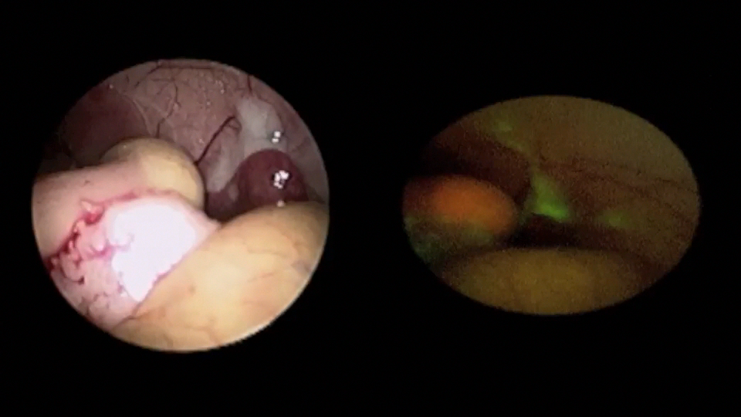
Metildi, et al. JACS 2012
Notes:
This is an illustration of the modified laparoscopic tower used to perform fluorescent laparoscopy. A 495 emission filter is placed between the camera and laparoscope and with alterations to the red, blue and green components of the L9000 LED light source, we are able to visualize any fluorescently labeled tumors.

Slide 41
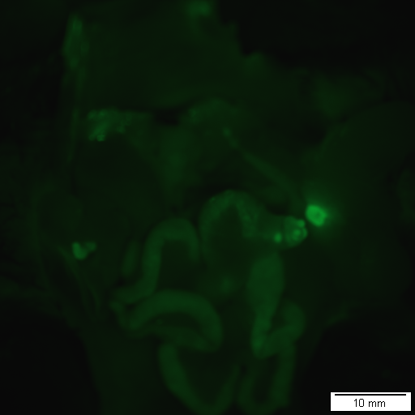
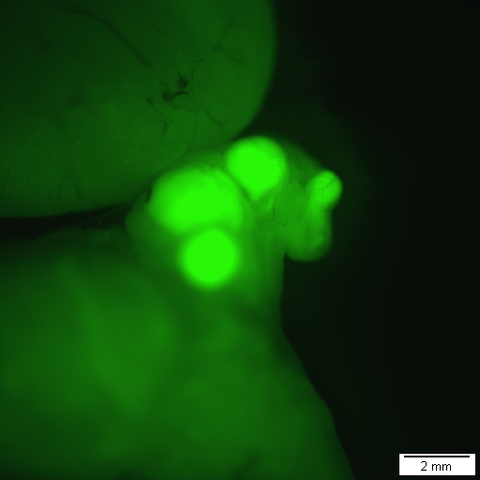
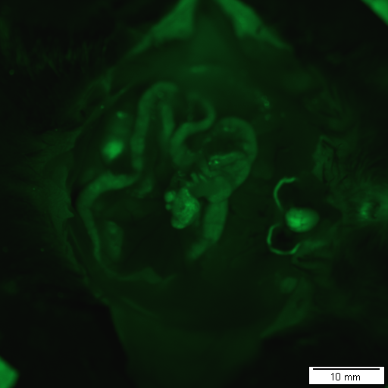
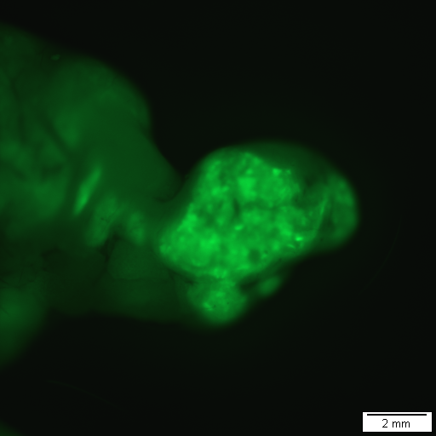
In Vivo Fluorescent Labeling of GIST
14x
56x
Cecal GIST
cecum
14x
56x
Cecal GIST
cecum
Metildi, Ann Surg Onc. 2013.
Notes:
Upon completion of laparoscopy, the mice were sacrificed and their abdominal cavities were exposed for imaging with the OV-100 Small Animal Imaging System using a GFP filter. The OV-100 images served as a control against which to compare the laparoscopic findings.
On whole body imaging, GFP labeling with the KIT antibody accurately detected the tumor in all four of the mice (Figure 3). There was no fluorescent labeling with the KIT antibody in all three of the wild type mice that were non-tumor bearing. There were 0 false negatives and two false positives – one transgenic mouse injected with IgG and one wild type mouse injected with IgG – yielding an accuracy of 92%.

Slide 42
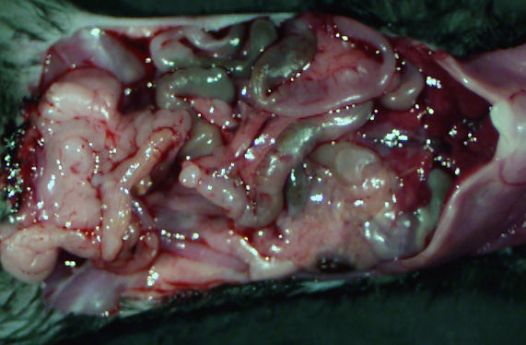
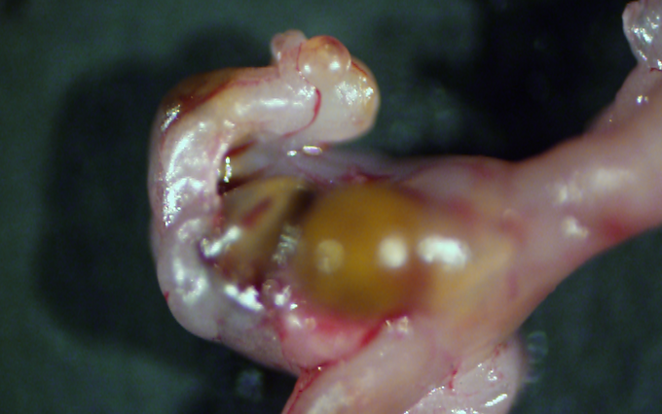
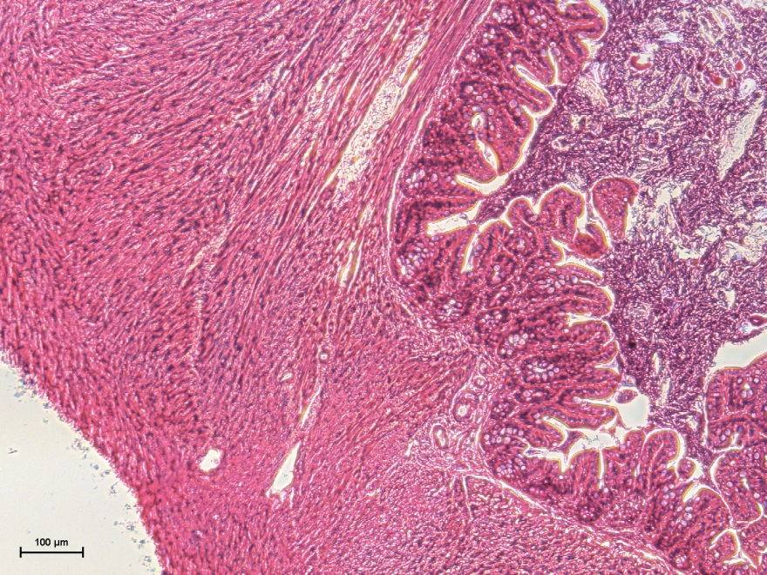
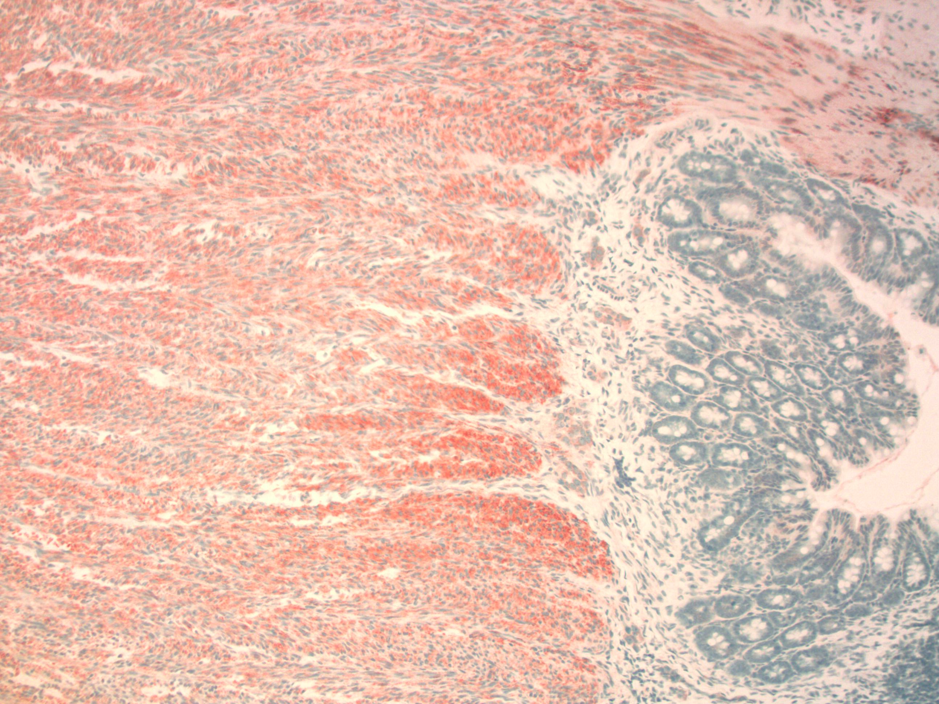
KIT K641E^{+/-} Transgenic Mouse Model of GIST
H&E
KIT
10x
10x
KIT K641E^{+/-}
Provided by B. Rubin, Cleveland Clinic
Notes:
We studied Kit K641E+/- transgenic mice that spontaneously develop cecal GISTs.
We used wild-type C57BL/6 mice for a negative control.

Slide 43
In Vivo Fluorescent Labeling of GIST
Multiple translatable surgical applications:
  Laparoscopic staging
  Assessment of margin status or residual disease

