Slide 1
Novel therapeutic strategies for GIST:
Targeting the tumor and treating the whole patient
GIST Patient Summit
MD Anderson Cancer Center, Houston, TX
September 16, 2017
Anette Duensing, M.D.
UPMC Hillman Cancer Center
University of Pittsburgh School of Medicine

Slide 2
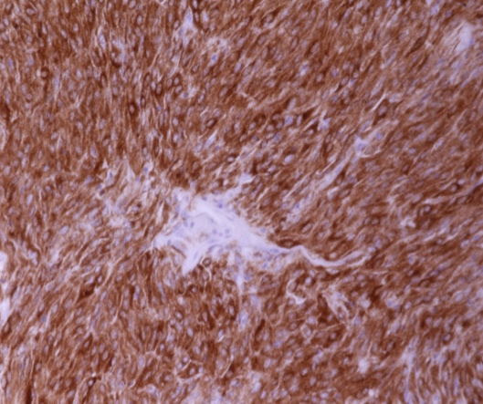
GISTs are caused by activating KIT mutations
high KIT protein expression
KIT gene mutations (75-85%)
→ gain of function
KIT mutation-negative cases
- PDGFRA (5-7%)
- “wildtype” (10-15%)
GIST: anti-KIT
KIT expression and KIT mutations in GIST:
- diagnostic marker
- therapeutic target
Heinrich MC, Corless CL, Duensing A, et al. Science 2003
Duensing A et al. Cancer Res 2004
Notes:
2
we all know that… (KIT mut, KIT expr)
PDGRFA, wildtype (will hear more about that from Dr. Sicklick)
bottom line:
KIT = very important marker to correctly diagnose GIST
THE main therapeutic target
first and foremost imatinib, gleevec (but also SU, REGO)

Slide 3
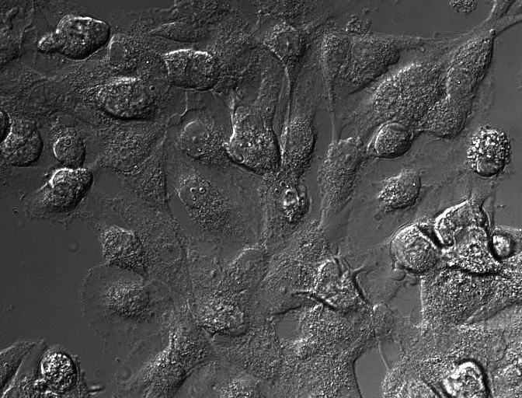
How does imatinib induce apoptosis in GIST cells?
GIST882:
treated with imatinib
72h incubation
30 min time frames
Notes:
- this is how it looks like in a tissue culture model when we treat gist cells with imatinib

Slide 4
Problem
incomplete remissions
disease recurrence
new therapies
new therapeutic strategies
to develop new therapies,
we need to know how exactly imatinib works
although imatinib is a pretty good drug,
what are potential flaws that we need to overcome?
Notes:
however, we all know that there are problems
mainly with …
new … are needed
and we have already heard today about very promising new therapeutic agents that are currently in clin trials
to develop further new therapies, …
…
flaws that we know about, binding to atp binding pocket (targeted by secondary mutations), binding to the inactive state of kit
others?

Slide 5
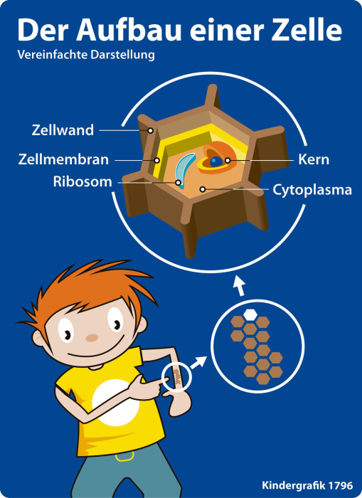
The cell
cell wall
nucleus
ribosome
cytoplasm
modified from: http://www.ntz.de
Notes:
first, give a little further intro on how kit signaling and gleevec work
look at a cell, we will zoom in to the molecular pathways
just as an example, take a cell of your skin

Slide 6
The cell
cell wall
nucleus
ribosome
cytoplasm
modified from: http://www.ntz.de
Notes:
using magnifying glass
see groups of cells
now look at one of these cells and what is in it, really closely, under the microscope

Slide 7
The cell
cell membrane
nucleus
ribosome
cytoplasm
modified from: http://www.ntz.de
Notes:
- border = cell membrane
inside = cytoplasm
nucleus = where dna is located
point out just one cellular organelle
ribosome, where proteins, molecules are made
will get back to that later

Slide 8
The cell
KIT
cell wall
nucleus
ribosome
cytoplasm
modified from: http://www.ntz.de
Notes:
now lets look at where kit is located
it is a molecule on the cell surface,
more specifically it spans the cell membrane
so it has an outside and an inside portion
now, lets look at this even more closely, at the molecular level
is a transmembrane receptor tyrosine kinase that regulates growth and survival of the cell

Slide 9
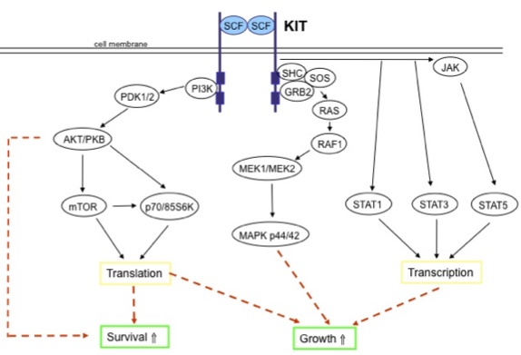
The cell
cell wall
nucleus
ribosome
cytoplasm
modified from: http://www.ntz.de
Notes:
highly regulated process
this process is dyregulated in GIST cells

Slide 10
Normal Function of KIT
SCF
SCF
KIT
Cell Membrane
Notes:
cell membrane
outside, inside of cell
kit receptor
reason for outside and inside portion of kit is that
it NORMALLY responds to cues from the microenvironment, outside of the cell
and relay those signals to the inside of the cell
tells the cell what to do, how to react
kit is activated by its so-called ligand, stem cell factor (SCF).
binding of scf to kit…

Slide 11
Normal Function of KIT
SCF
SCF
KIT
Cell Membrane
SHC
JAK
SOS
PDK1/2
PI3K
GRB2
RAS
AKT/PKB
RAF1
MEK1/MEK2
mTOR
p70/85S6K
STAT1
STAT3
STAT5
MAPK p44/42
Translation
Transcription
Survival Signals ⇑
Growth Signals⇑
Notes:
activates kit
Leads to receptor dimerization, autophosphorylation and activation of downstream signaling cascades
eventually leads to survival and growth signaling
you don’t need to remember any of the complicated names here,
but I would like to point out one survival factor,
akt
will come back to that later

Slide 12

Normal Function of KIT
KIT
Cell Membrane
SHC
JAK
SOS
PDK1/2
PI3K
GRB2
RAS
AKT/PKB
RAF1
MEK1/MEK2
mTOR
p70/85S6K
STAT1
STAT3
STAT5
MAPK p44/42
Translation
Transcription
Survival Signals ⇓
Growth Signals ⇓
Notes:
however, when scf dissociates again from kit
the signaling cascades are turned off again

Slide 13
KIT in GIST
Cell Membrane
mutated
KIT
Notes:
HOWEVER, this is different when kit is mutated
mutated kit does not need scf to be activated

Slide 14
KIT in GIST
Cell Membrane
mutated
KIT
SHC
JAK
SOS
PDK1/2
PI3K
GRB2
RAS
AKT/PKB
RAF1
MEK1/MEK2
mTOR
p70/85S6K
STAT1
STAT3
STAT5
MAPK p44/42
Translation
Transcription
Survival SIgnals ⇑
Growth Signals ⇑
Notes:
it is always active
(itutive ligand-indepdent activation)
like a gas pedal that is stuck
so, the growth and survival signals in the cell are always on

Slide 15
How to stop KIT signaling in GIST?
?
KIT
Cell membrane
SHC
JAK
SOS
PDK1/2
PI3K
GRB2
RAS
AKT/PKB
RAF1
MEK1/MEK2
mTOR
p70/85S6K
STAT1
STAT3
STAT5
MAPK p44/42
Translation
Transcription
Survival Signals⇓
Growth Signals⇓
Notes:
we all know how to stop this hyperactive kit signaling in GIST

Slide 16
How to stop KIT signaling in GIST?
Stop
KIT
Cell membrane
SHC
JAK
SOS
PDK1/2
PI3K
GRB2
RAS
AKT/PKB
RAF1
Gleevec® (imatinib)
Sutent® (sunitinib)
Stivarga® (regorafenib)
MEK1/MEK2
mTOR
p70/85S6K
STAT1
STAT3
STAT5
MAPK p44/42
Translation
Transcription
Survival Signals⇓
Growth Signals⇓
Notes:
gleevec, sutent, stivarga…
ok, so much about kit signaling details
we can now have a closer look at imatinibs mechanism of action
Imatinib mesylate (Gleevec®, Novartis) is a small molecule protein tyrosine kinase inhibitor that was originally identified in a screen for PDGFR (platelet derived growth factor receptor) inhibitors [68]. It competitively binds to the kinase ATP binding pocket, and also effectively inhibits not only PDGFRA/B, but also the KIT and ABL kinases because of structural similarities of their kinase domains

Slide 17
Is inhibition of ABL by imatinib beneficial for GIST treatment?
imatinib inhibits:
KIT
PDGFRA
PDGFRB
BCR-ABL (chronic myeloid leukemia)
ABL
normal ABL has various cell protective functions
Notes:
you probaby all know that although IM is fairly specific to inhibit kit
is also inhibits a fe other molecules
first, the related pdgfra and beta
good, because some pdgfra muts are sensitive to IM
but, IM was first developed and used clinically to inhibit another kinase
the abnormal bcr-abl kinase
that is constitiutively activated by a chromosomal rearrangement
(not a mutation)
in CML
but while bcr-abl is a protein/molecule that is only found in leukemia cells
the normal abl kinase is found in almost all normal cells
presumably also in gist cells
normal abl, however, has a bunch of protective functions in a cell
like stopping the cell from dividing after its dna got damaged
so, we asked what role inhibition of the abl kinase by IM plays in a gist celll
beneficial?
for example, it has been shown that it is beneficial to inhibito the kit kinase in cml cells…

Slide 18
ABL is present in GIST cells
Rausch J, et al. Oncotarget 2017
Notes:
first, needed to test whether abl is indeed present in gist cells
short answer, it is
on the left various gist cell lines
as well as cml cell line
abl present in all gist cell lines
abnormal bcr-abl only in cml cell line, bigger
we also looked at primary tumor tissu
on the right
all of the nearly 30 gists that we looked at were positive for abl

Slide 19
“Inhibiting” KIT and ABL kills less GIST cells than “inhibiting” KIT alone
Rausch J, et al. Oncotarget 2017
Notes:
we then used a specific technique
called small interfering rna (sirna)
to mimic inhibition of only kit, only abl or inhibiting both (hence mimicking imatinib)
in gist cells
surprised to see that
“inhibiting” kit and abl together kills less gist cells that inhibiting kit alone
what could be the cause of this?

Slide 20
ABL is a survival factor in GIST cells
DMSO
Rausch J, et al. Oncotarget 2017
new KIT inhibitors for GIST should have increased specificity for KIT and reduced ability to inhibit ABL
sunitinib, regorafenib → no significant ABL inhibition
nilotinib, dasatinib → strong ABL inhibition
BLU-285, DCC-2618
Notes:
in further experiments, we found that
inhibition of abl – either with the sirna technique or with a specific abl inhibitor that does not inhibit kit
leads to activation of the survival factor akt
we could also show in the abl activity assay
that im strongly inhibits ab
whereas su and rego do not
we can therefore conclude that
…
our data help to explain the effectiveness of SU and REGO
as well as the relative ineffectiveness of NILO and DAS in GIST
out data also support the development of new drugs
such as BLU and DCC
that tackle KIT inhibition by using a different mech of action
not via the ATP binding site
and thereby yield more specific KIT inhiitiors

Slide 21
Novel therapeutic strategies in GIST
Cell Membrane
mutated
KIT
SHC
JAK
SOS
PDK1/2
PI3K
GRB2
RAS
AKT/PKB
RAF1
MEK1/MEK2
mTOR
p70/85S6K
STAT1
STAT3
STAT5
MAPK p44/42
Translation
Transcription
Survival SIgnals ⇑
Growth Signals ⇑
Notes:
now switch to novel therapeutic strategies developed in our lab
another way of targeting kit
not by inhibiting kinase activity

Slide 22
Getting rid of KIT...
KIT
Cell Membrane
SHC
JAK
SOS
PDK1/2
PI3K
GRB2
RAS
AKT/PKB
RAF1
MEK1/MEK2
mTOR
p70/85S6K
STAT1
STAT3
STAT5
MAPK p44/42
Translation
Transcription
Survival SIgnals ⇑
Growth Signals ⇑
Notes:
- is to get rid of the entire molecule

Slide 23
Stops KIT signaling in GIST!
KIT
Cell membrane
SHC
JAK
SOS
PDK1/2
PI3K
GRB2
RAS
AKT/PKB
RAF1
MEK1/MEK2
mTOR
p70/85S6K
STAT1
STAT3
STAT5
MAPK p44/42
Translation
Transcription
Survival Signals⇓
Growth Signals⇓
Notes:
this is a good strategy
because we know that tki-resistant gists are still dependent on kit signaling
but because secondary mutations can be different in different tumor nodules and even different regions of the same tumor
it can be impossible to choose the correct inhibitor for the entire tumor load of a given patient
before we go into our studies,
we need to do a little more biology 101…

Slide 24
How is KIT made?
(from DNA to protein)
5. done!
4. Golgi
protein conformation
translation
(from RNA to protein)
3. rER
protein assembly
1.DNA
2. mRNA
transcription
(from DNA to RNA)
Das Lebenshaus
Notes:
need to look at the intracellular steps at how the kit protein is made
(involves the ribosome cellular organelle that I mentioned in the beginning, the ribosome)
dna-rna --> transcription
rna-ribosome --> translation
protein is made
golgi-final modifications
cell membrane
so, how can we target this process/any of these steps?
transcription
translation
some surprising
lets start with trasncription

Slide 25
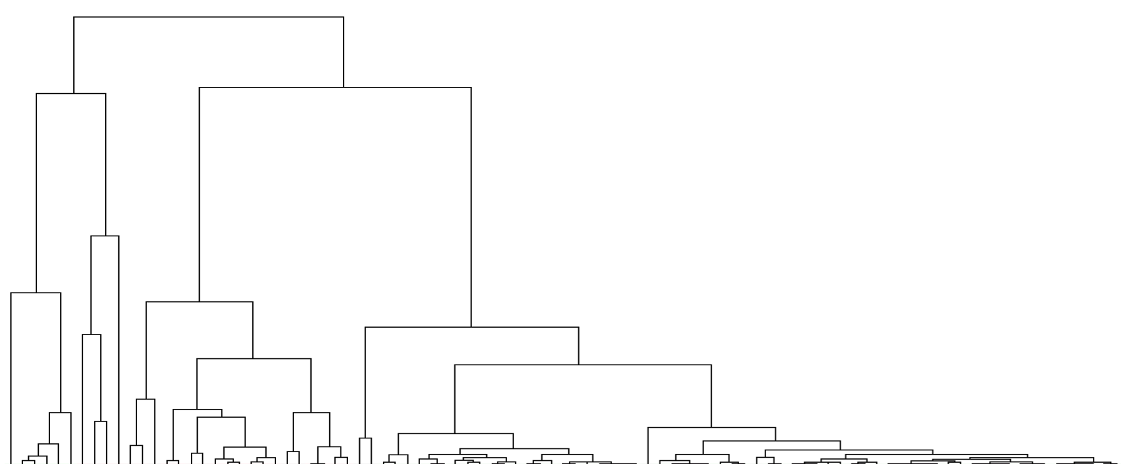
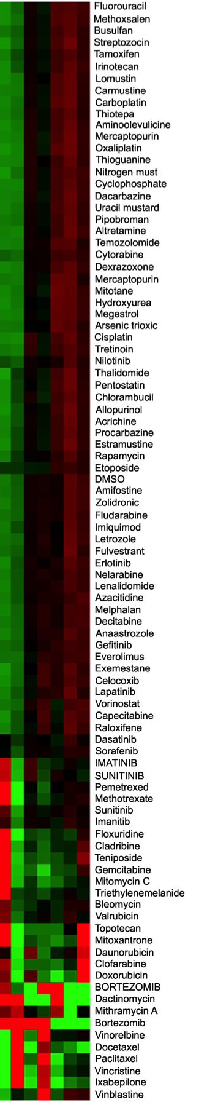
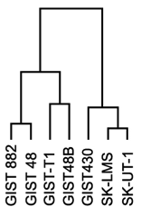

GISTs are sensitive
to transcriptional inhibitors
GIST
LMS
transcriptional
inhibitors
effective
ineffective
Boichuk S et al., Cancer Research 2014
Notes:
surprise result from a drug screen
100 fda approved drugs
mostly chemo
tested in gist cell lines – versus leiomyosaroma
didn’t really expect much, because chemo isnt supposed to work in gist
however, 2 drug classes were very effective
one of them, transcriptional inhibitors
(topo II inhibi, I wont talk about today)

Slide 26
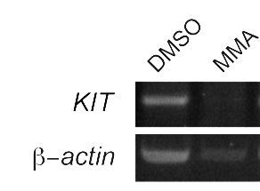
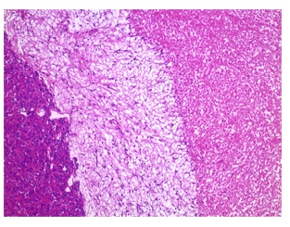
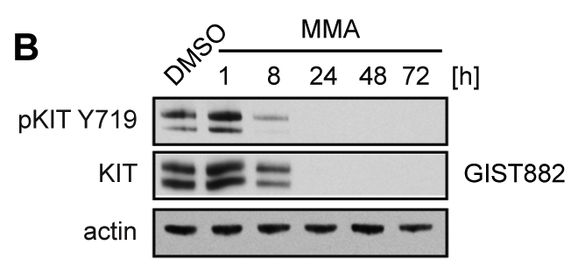

Mithramycin A:
killing GIST cells by inhibiting KIT transcription
GIST882
RT-PCR
tu
myx
nec
Boichuk S et al., Cancer Research 2014
Notes:
when we took a closer look at the transcriptional inhib
we could should that one of their main mech of action was to inhibit the transcription of KIT
shown here by reduced kit mrna levels
as expected, this leads to reduced kit prot levels
and hence reduced levels of activated kit
happens really fast too – within the first 8 hours of treatment
because gist cells are addicted to kit activation
this effectively kills GIST cells
imporatnely, also im-resistant cells
and in a gist mouse model
currently trying to translate finding into clinical trial
but a little difficult, because MMA is not manufactured anymore

Slide 27
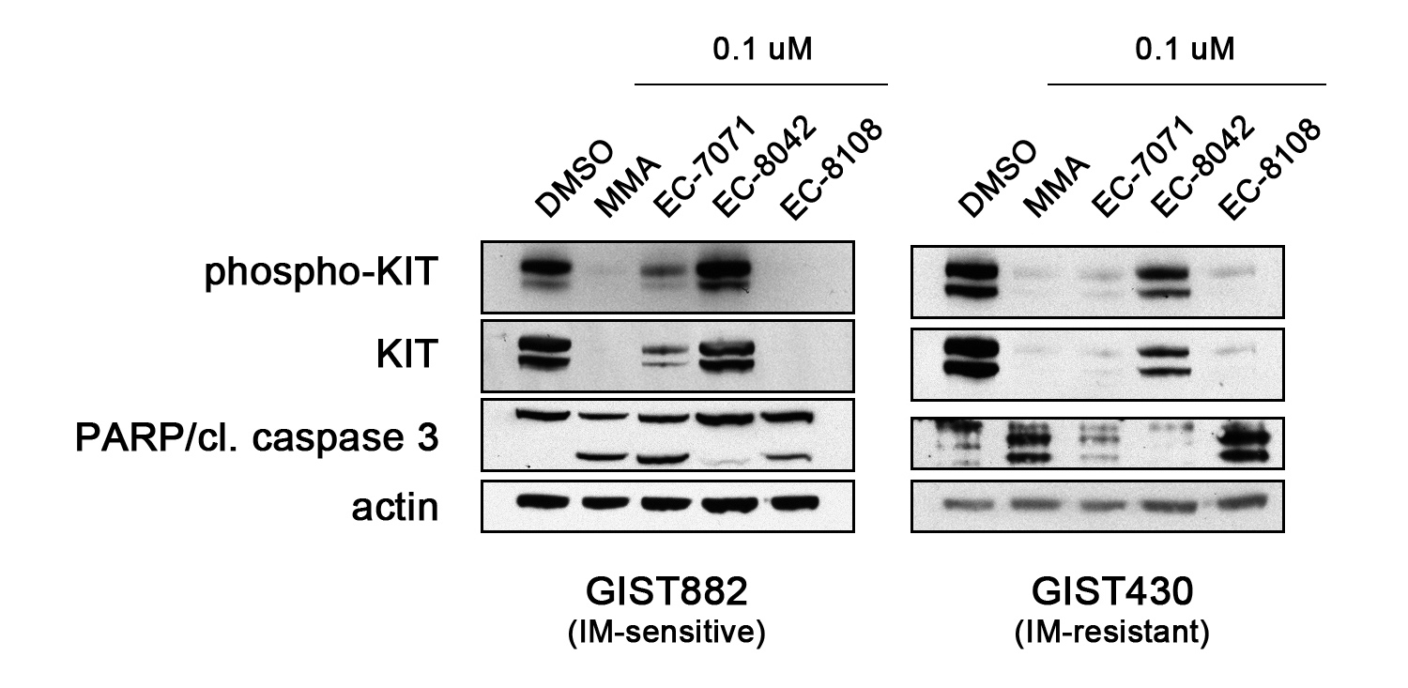
Mithramycin A analogs:
same activity, but better toxicity profile
collaboration with EntreChem, Ovieda, Spain
analog 1
analog 3
analog 2
analog 1
analog 3
analog 2
Jessica Rausch - unpublished
Notes:
spin off of these results
collaboration with a company in spain
spin off of the university of ovieda
mithramycin analogs
less toxic
tested small panel
good activity for some
ongoing project
but company has already extensive data for some of these compounds, including another sarcoma
so, hopeful that this could eventually lead to clinical trial

Slide 28
GISTs are sensitive
to transcriptional inhibitors
GIST
LMS
transcriptional
inhibitors
ineffective
Boichuk S et al., Cancer Research 2014
Notes:
second drug that was a hit in our screen
and grouped with the transcriptional inhibitors
belongs to the class of proteasome inhibitors
bortezomib, velcade
these are drugs that inhibit protein degradation
not trasncriptional inhibitors per se
however
we could show that bortezomib, just as mithramycin a,
also leads to a loss of kit protein
and that this is mediated through transcriptional inhibition
wont show these data today
but will move forward to what we call second gen prot inhib

Slide 29
Second generation inhibitors of the 26S proteosome
Notes:
why?
although BO is FDA approved for a type of blood cancer
multiple myeloma
it has less than ideal pharmacological properties (adverse effects, iv, apparently less activity in solid tumors)
we have therefore tested a small array of new prot inhib for their effectiveness in gist
two of them are already FDA-approved
again for MM

Slide 30
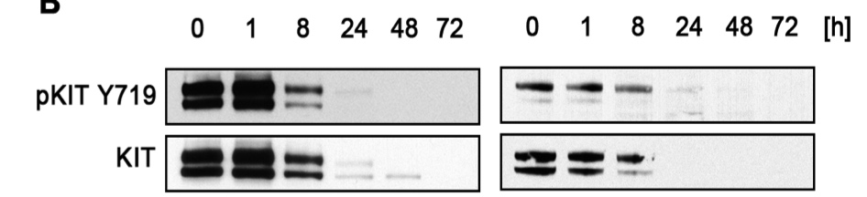
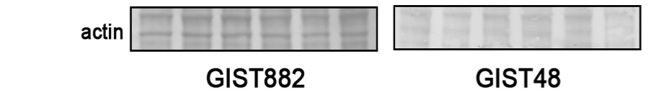
Inhibitors of the 26S proteasome inhibit KIT transcription similar to bortezomib
IM-resistant
DLZ
Delanzomib (DLZ)
Bortezomib (BO)
GIST48
second-generation 26S proteasome inhibitors are
  effective in GIST
  have the same mechanism of action as bortezomib
planning clinical trial through NCI CTEP
IM-resistant
IC50:
Bortezomib: 15 nM (10 nM)
Delanzomib: 20 nM (11 nM)
Ixazomib: 90 nM (50 nM)
Carfilzomib: 500 nM (130 nM)
Rausch JL et al, CTOS 2014
Notes:
we could show that all 3 drugs, similarly to BO, are effective in GIST
dlz best
very effectively and quickly kills gist cells through
transcriptional inhibition of kit
interestingly, all of the drugs are more effective in im-res gist cells
planning clin trial

Slide 31
How is KIT made?
(from DNA to protein)
translation
(from RNA to protein)
transcription
(from DNA to RNA)
Das Lebenshaus
Notes:
now switch to targeting protein translation
tested the first fda-approved translational inhibitor for its activity in gist

Slide 32
Inhibition of translation leads to loss of KIT and effectively kills GIST cells
inhibition of protein synthesis
Patil SS et al, CTOS 2016
Homoharringtonine (Synribo®)
inhibitor of protein translation
FDA-approved for treatment of imatinib-resistant chronic myeloid leukemia
Notes:
32
hht
extract from the japanese plum yew
fda-approved for im-res cml
could show that strong effect on gist cells
including im-res
fast
very strong inhibition of protein synthesis
just as strong as chx, a drug that is commonly used in the lab for this purpose, but too toxic to use in patients
finishing up
hopefully moving to clinical trial soon

Slide 33
Take-home messages
(Part I)
development of KIT kinase inhibitors to target GIST should include reducing their ability to inhibit the ABL kinase
eliminating KIT protein expression via
  inhibition of DNA transcription or
  inhibition of protein translation
  are promising treatment strategies for TKI-resistant GIST
Notes:
take home…
now switching gears juuusst a little bit…

Slide 34

choosehope.com
Notes:
I would like to introduce you to a new study that I am initiating with collaborators of the Biobehavioral oncology program and the dept of neurology at pitt
(maybe you have already seen this sheet in your conference package?)
this study was inspired by you and the GSI mailing list
hearing GIST pts talk about Gleevec brain
in analogy to chemo brain

Slide 35
To Do:
Buy fresh lime for the fiesta tonight
pick up the cat’s medicine at the vet’s
Buy a new bike helmet for Jr.
Notes:
before I go into details though
I have a short to do list for you…
read…
I will come back to that later
memorize!

Slide 36
“Chemo-brain”
(Chemotherapy-related cognitive dysfunction)
first described in the 1980s:
”Chemotherapy is associated with measurable decrements in neuropsychological test performance” (Silberfarb et al.)
Prevalence: ~15-80% depending on study
what is affected?
verbal memory, working memory, visual-motor processing speed
usually mild, not progressive impairments
often confounded by
  age, education, IQ, pre-morbid neurologic impairment, depression, anxiety fatigue, substance use
Notes:
back to a little history about chemobrain
also called…
…

Slide 37
Life after diagnosis and treatment of cancer in adulthood
Stanton A, Rowland JH, Ganz PA, American Psychologist, 70, 159-174
Notes:
if you look at this study about long-term cancer surviors and
their perceived problems/issues, even after treatment completion
you can see that
cogn. dysfx stays with them for a long time

Slide 38
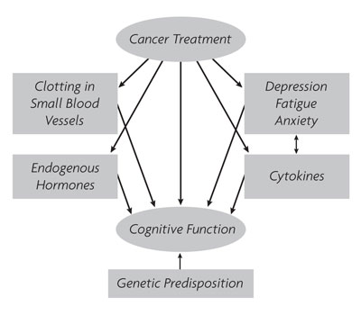
What causes chemo-brain?
(And why does not everyone get it?)
widely varying hypothesized mechanisms
direct neurotoxicity and cell death
white matter degradation
pro-inflammatory cytokines (“the immune system”)
estrogen suppression – hormone therapy
stress?
Pine Street Foundation, Becoming Your Own Advocate Newsletter, 2005
Notes:
so, the question is…
…
bottom line,
everything might be - or is – interconnected
took a long time to realize that chemo brain is real

Slide 39
So, chemo-brain is real. But…
Why do many patients still have normal neuropsychological testing scores?
Where is the impairment?!
Notes:
is this really a problem?

Slide 40
Ferguson RJ et al., Journal of Clinical Oncology, 2007
Notes:
twin study
identical twins
one twin affected by breast cancer, treated with chemo
reported cog dysfx, but had some score on neuropsychological testing as her unaffected twin
brain scan while performing tasks
left > right task gets more difficult
brain of the breast ca twin has more active areas that of the unaffected twin
she got things done,
but her brain was working harder
affects daily performance
biological vulnerability
under greater demand manifestation of problems with daily tasks
study was replicated with multiple survivors

Slide 41
The chemo-brain (has to) work harder to get things done.
What are the consequences?
social life, family, employment…
And what to do about it?!
Notes:
is this really a problem?

Slide 42
MAAT – Memory & Attention Adaptation Training
Memory & Attention
Adaptation Training
cancer-related
cognitive dysfunction
4 treatment components
Education and “memory failure reattribution”
Self-awareness training
Self-regulation and stress management
Cognitive Compensatory strategies
Notes:
there is actually something that can be done about this
cognitive behavioral tx
just as an outlook where we might be going with this

Slide 43
It works!
cognitive impairments
neurocognitive processing speed
quality of life
Notes:
and this works
participants had less cog impairments
a better neurocog processing speed and
a longer lasting better QoL
ratings were also very good
tx can be performed online or through video-conferencing
however…

Slide 44
Nothing is known…
… about cognitive dysfunction
in patients on long-term
tyrosine kinase inhibitor therapy.
Like you!
Notes:
however, nothing is known…

Slide 45
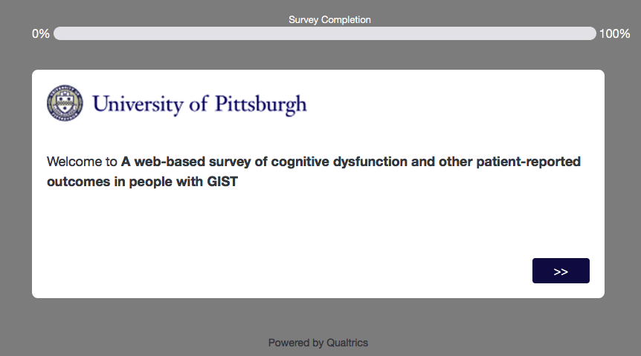



A web-based survey of cognitive dysfunction
and other patient-reported outcomes
in people with GIST
Dr. Robert J. Ferguson, PhD
Biobehavioral Oncology Program
UPMC Hillman Cancer Center
University of Pittsburgh School of Medicine
Dr. Dana Bovbjerg, PhD
Director, Biobehavioral Oncology Program
UPMC Hillman Cancer Center
University of Pittsburgh School of Medicine
Dr. Beth E. Snitz, PhD
Department of Neurology
University of Pittsburgh School of Medicine
Notes:
set out with my collaborators to
design a
study aims to asses cognitive dysfunction
so, problems with memory, learning, problem solving
in patients on tki
nothing known!
inspired by you…!
so, part of my mission here today
is to introduce this study to you
and to ask for your help and participation
but before I go into this…
so, this isnt really about “chemo”brain per se
but
is this really a problem?

Slide 46
What were the 3 items that you were assigned to remember?

Slide 47

Notes:
was it that?
I didn’t do that///

Slide 48
What is our survey about?
What will we ask?
1. some basic questions:
basic demographics
basic clinical and treatment history
2. standardized questionnaires asking about:
  general health
  perceived cognitive impairments
  fatigue
  sleep disturbance
  emotional distress – depression
  pain

Slide 49
Important to know...
  validated, widely used questionnaires with strong psychometric properties
  PROMIS
  (patient-reported outcomes measurement information system)
    library for health care researchers to measure health with valid and reliable questionnaires about symptoms, function and quality of life
    access for researchers through credentialed registration process
    limits spread of questionnaires and copyright violations
  standardized reference populations
    normed on thousands of patients and healthy individuals
  numerical rating scale

Slide 50
Important to know...
  completely anonymous
  no personal or private health information is being asked
  nobody can be identified

Slide 51

auburnplayers.org
WE WANT YOU
to directly participate in our research!

Slide 52
Now! (And later...)
  take our survey (once it goes live...)
  will be posted on GSI listserv and GSI Facebook page
  let us know if we missed something
  fill out form in your conference package
  leave with me or the conference organizers
  (Ginger, Marina...)
  or: email me with suggestions: aduensin@pitt.edu

Slide 53





Acknowledgements
Duensing Lab
Lijun Liu
Donna Lee
Sneha Patil
Areej Ali
Jessica Rausch
Aya Agha
Keith Mehalek
Kathleen Makielski
Sergei Boichuk
Joshua Parry
Derek Lee
Julianne Baron
James Zewe
Matt Brown
Dee Seneviratne
Ying Liu
University of Pittsburgh
Nduka Amankulor
Aparna Rao
Jason Kim
Kurt Weiss
Melissa Burgess
Shih-Fan Kuan
Brigham & Women's Hospital
Jonathan Fletcher
Katholieke Universiteit Leuven
Maria Debiec-Rychter
Agnieszka Wozniak
Patrick Schöffski
Universität Duisburg-Essen
Sebastian Bauer
MSKCC
Cristina Antonescu
Peter Besmer
Dana Farber Cancer Institute
James A. DeCaprio
Larisa Litovchick
Kochi Medical School
Takahiro Taguchi
UC Davis
Nikolai Tomilin
Joseph Siino
Cleveland Clinic
Brian Rubin
University of Pittsburgh Cancer Institute
numerous private donors
Notes:
53

Slide 54
Conclusions
NEED TO REVISE TO INCLUDE ALL OF THE PREVIOUS CHEMO BRAIN
MAAT appears to be more effective than other cognitive behavioral therapy.
MAAT likely has positive sustained effects on quality of life (less anxiety about cognitive failures).
It can readily be delivered electronically with high survivor satisfaction.

Slide 55
auburnplayers.org
WE WANT YOU

Slide 56
ABL is a survival factor in GIST cells
Rausch J, et al. Oncotarget 2017
new KIT inhibitors for GIST should have increased specificity for KIT and reduced ability to inhibit ABL
sunitinib, regorafenib → no significant ABL inhibition
nilotinib, dasatinib → strong ABL inhibition
BLU-285, DCC-2618
Notes:
in further experiments, we found that
inhibition of abl – either with the sirna technique or with a specific abl inhibitor that does not inhibit kit
leads to activation of the survival factor akt

